Slide 1
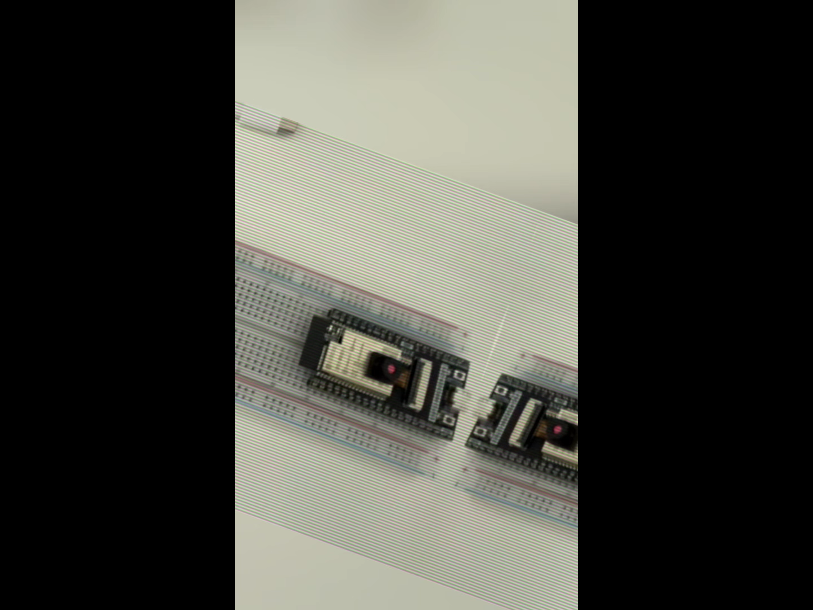

Slide 2
Smart Health & Fire Monitoring System Based on ESP32 and iPad Dashboard
🧠 Health + 🔥 Fire dual monitoring
📱 iPad real-time UI, 🧩 sensor fusion, 📷 event validation
T2 UNIVERSITY OF MISSOURI-KANSAS CITY
Hui Jin May 5, 2025
Jiarui Zhu
Changyu Liu
Yiyang Liu

Slide 3
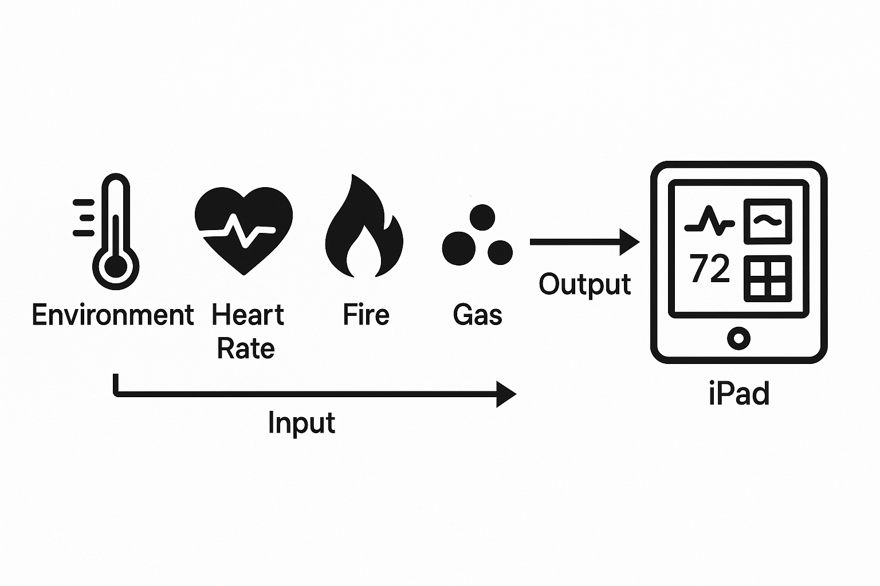
Project Motivation & Goals
Realistic problem: Sudden health risks and fire hazards of elderly people living alone are difficult to detect in time
Technical goal: Realize real-time monitoring, abnormality detection, and remote reminders
Innovation: Based on ESP32 low-power solution + multi-mode sensor + local wireless transmission + iPad UI display

Slide 4
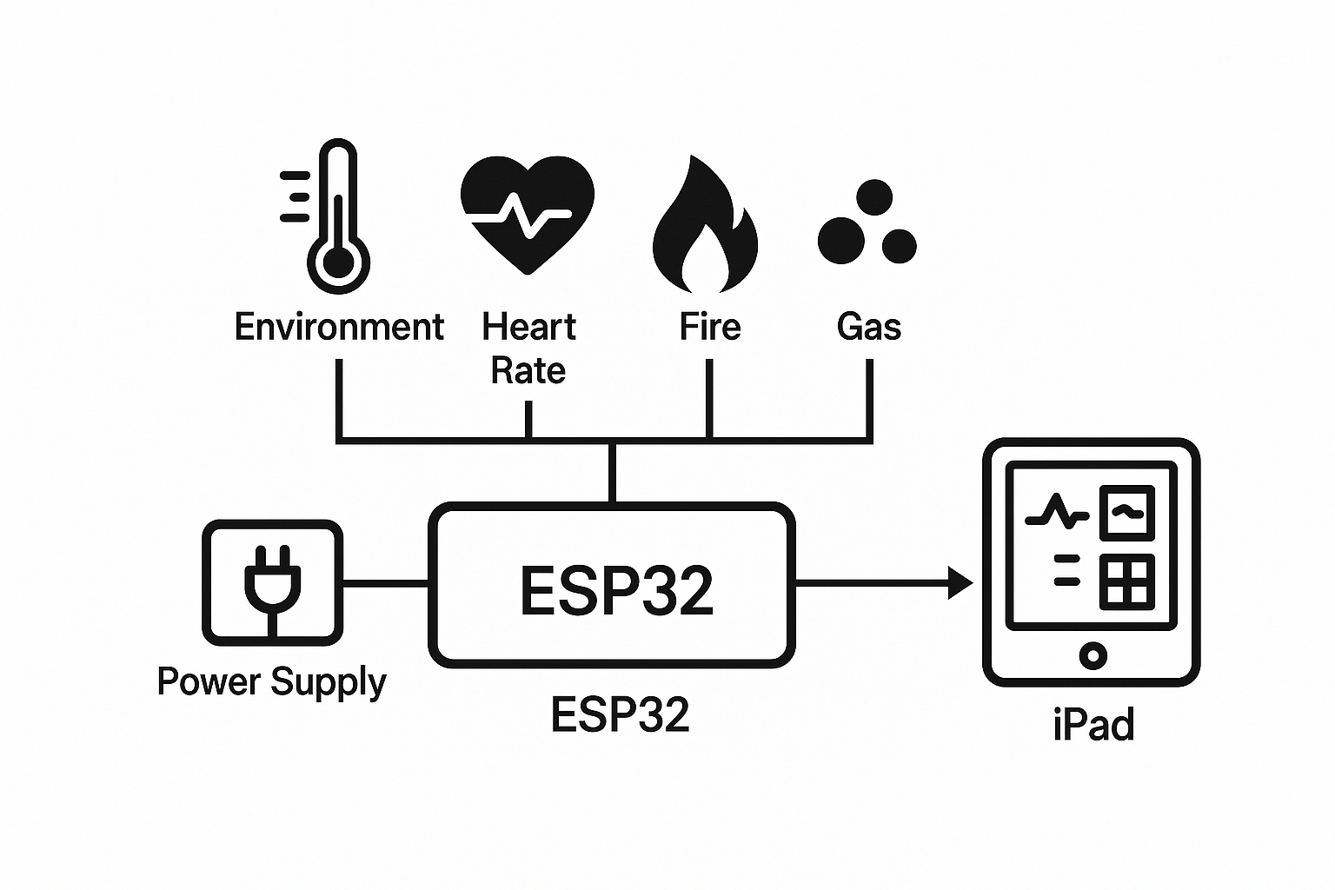
System Architecture Overview
ESP32 master node collects 5 types of sensor data (environment/health/fire condition)
Use ESP-NOW communication to send data to receiving ESP32
The receiving end transmits data to iPad interface via WI-FI
iPad Dashboard is responsible for real-time display and can trigger alarms

Slide 5
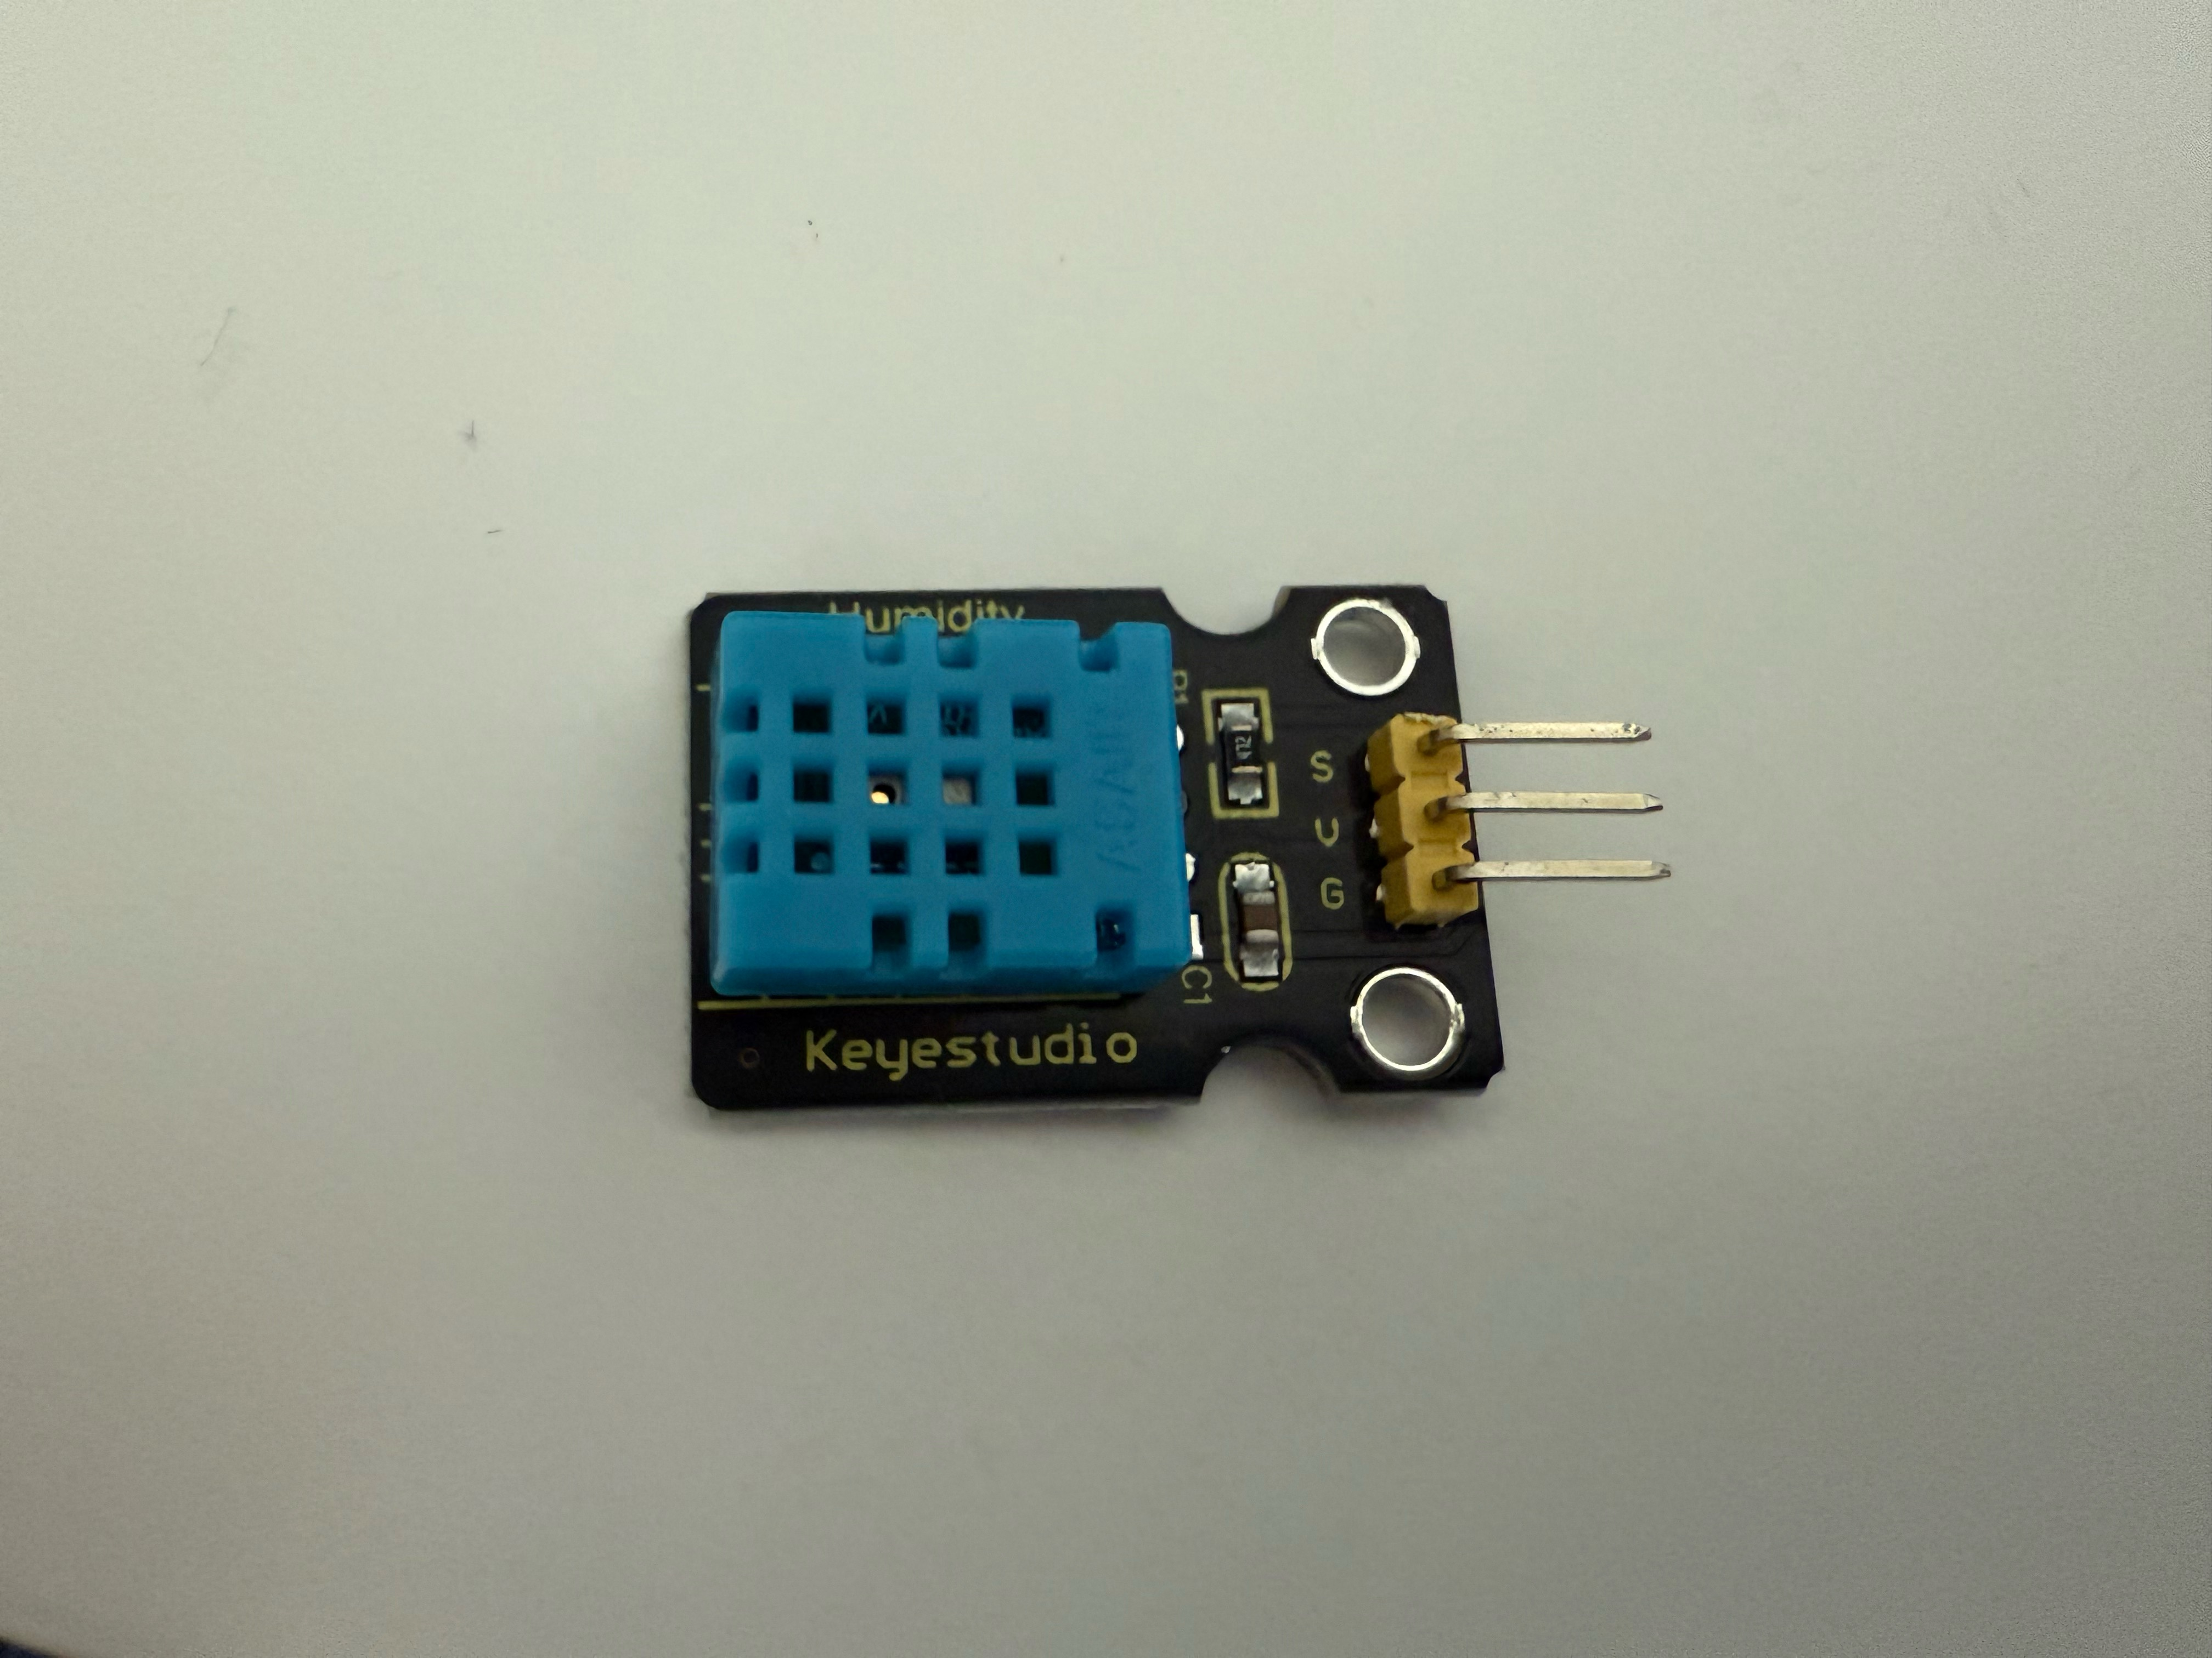
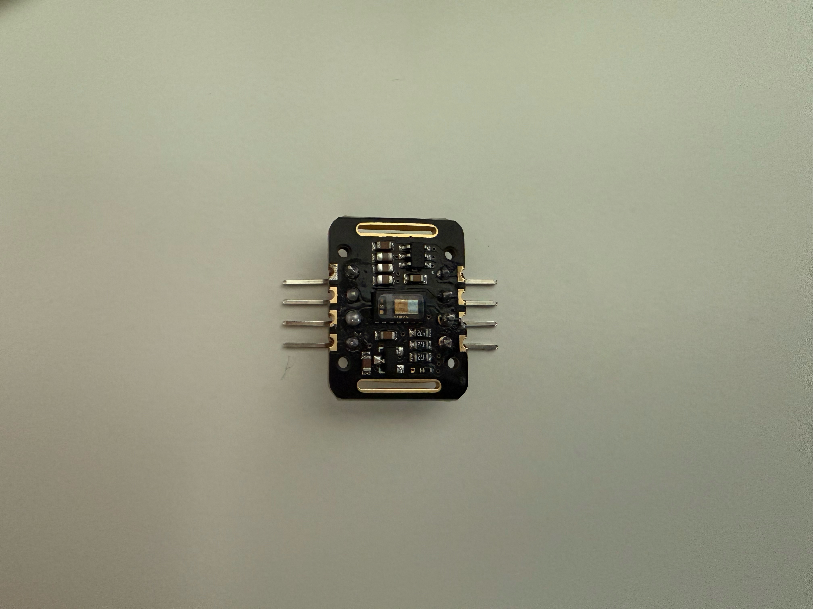
Sensor Acquisition Module
DHT11 & MAX30102
Temperature and humidity sensor DHT11: Get ambient temperature/humidity.
Heart rate blood oxygen MAX30102: Get BPM and SpO₂, using custom peak detection.

Slide 6
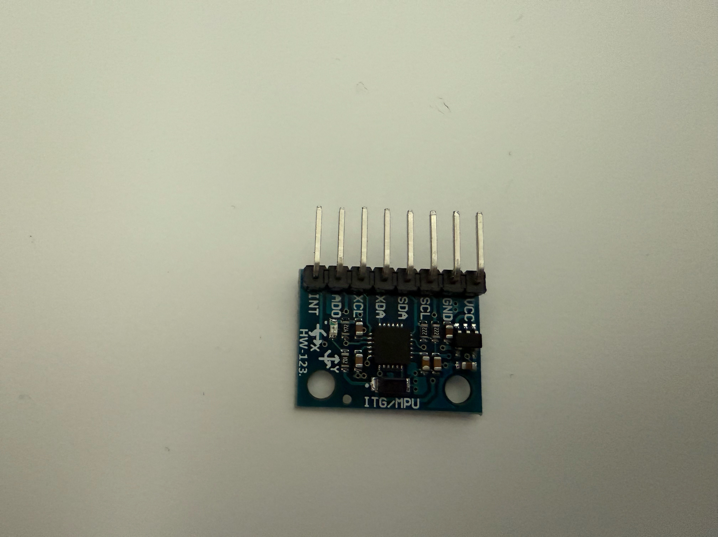
Sensor Acquisition Module
MPU6050
MPU6050: Detect acceleration and determine dynamic behaviors such as falls.
Judgment rules:
When the absolute value of the Z-axis acceleration is < 1.0, it is judged as a fall/abnormality (displayed in red)
When the absolute value of the X or Y-axis acceleration is > 2.0, it is judged as violent exercise (displayed in orange)
Other situations are normal (displayed in green)
Displayed in gray when there is no data

Slide 7
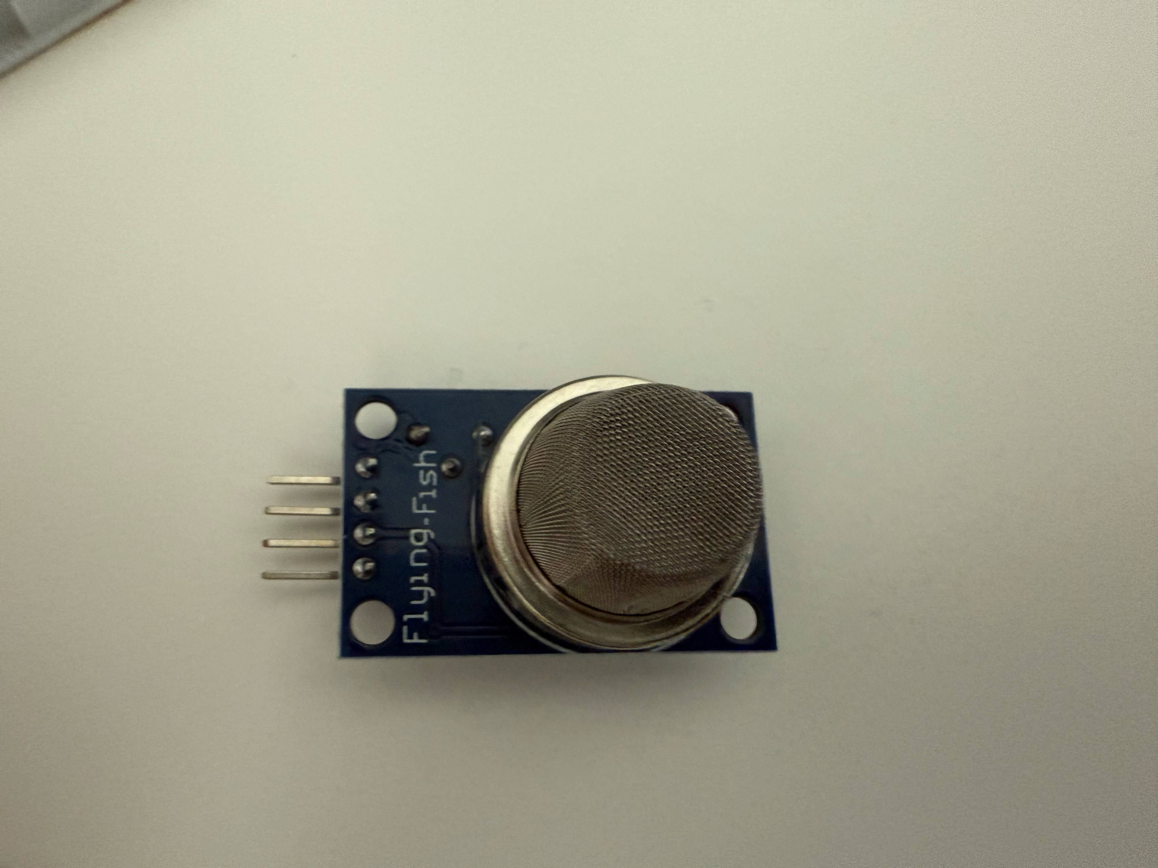
Sensor Acquisition Module
MQ135
MQ135: Used to assess the "pollution level" of indoor environments
Judgment rules:
When the gas sensor value is between 0-800, the air quality level is "Excellent" and is displayed in green.
When the gas sensor value is between 801-900, the air quality level is "Good" and is displayed in yellow.
When the gas sensor value is between 901-1000, the air quality level is "Light Pollution" and is displayed in orange.
When the gas sensor value is between 1001-1100, the air quality level is "Moderate Pollution" and is displayed in red.
When the gas sensor value is between 1101-1200, the air quality level is "Heavy Pollution" and is displayed in purple.
When the gas sensor value is greater than 1200, the air quality level is "Severe Pollution" and is displayed in brown.

Slide 8
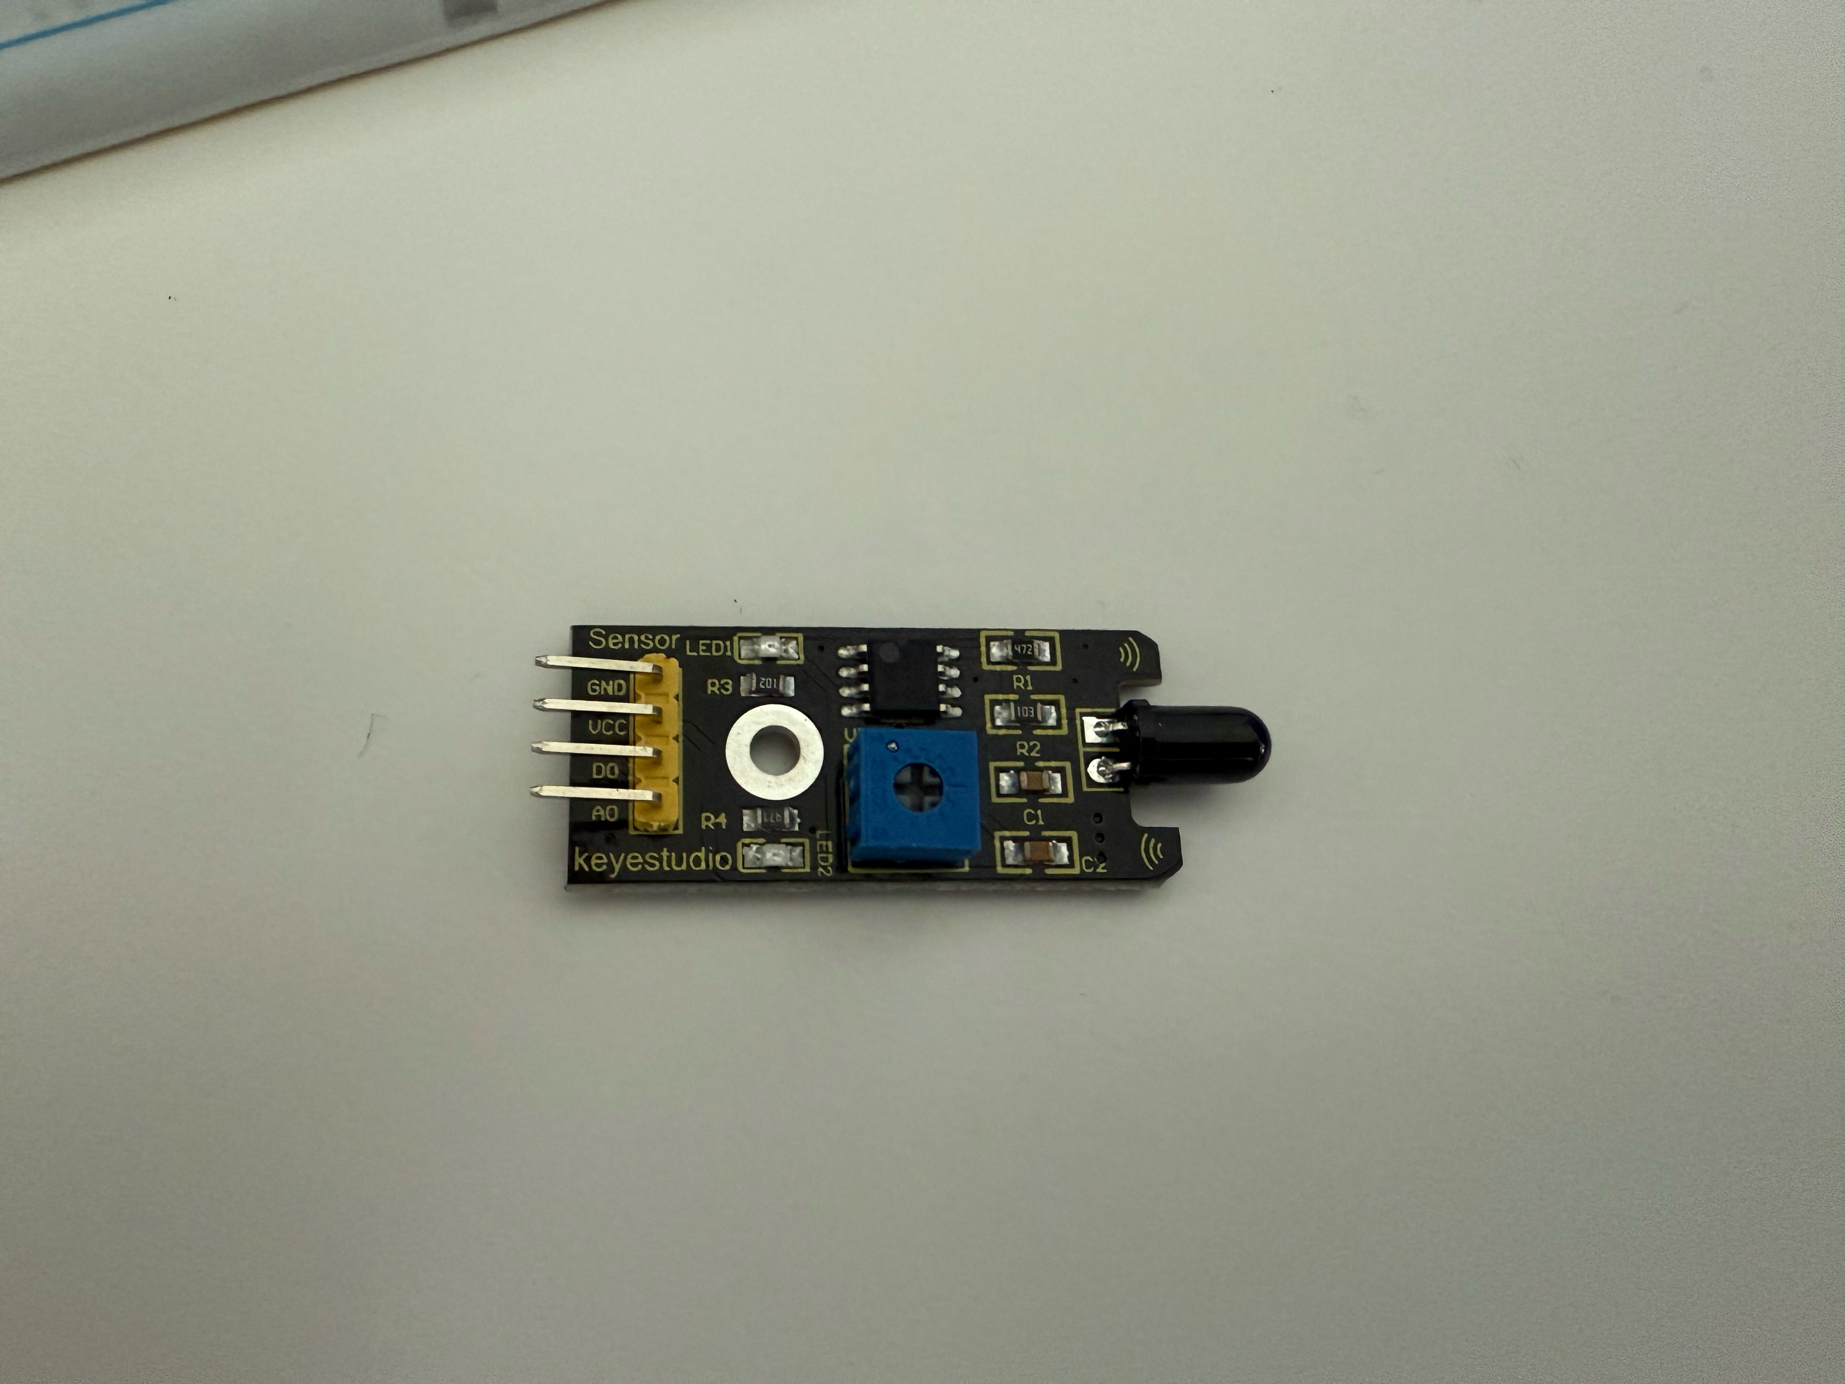
Sensor Acquisition Module
Flame Sensor
Flame sensor: can identify the infrared light emitted by flames (usually with a wavelength of 760nm–1100nm)
Judgment rules:
When flameAnalog < 2000, it indicates a fire is detected.
When flameAnalog >= 2000, it indicates a normal state.

Slide 9
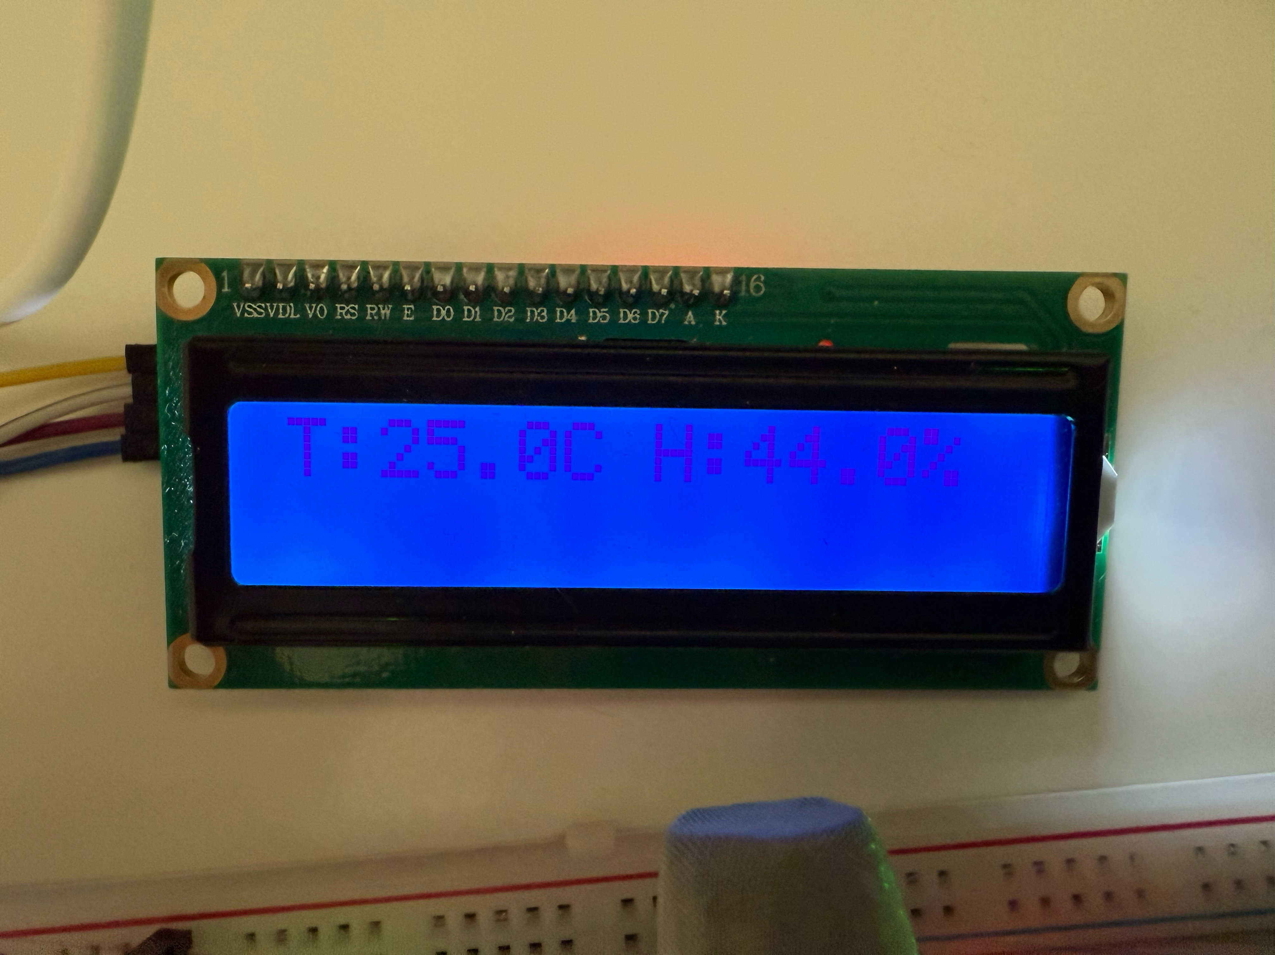
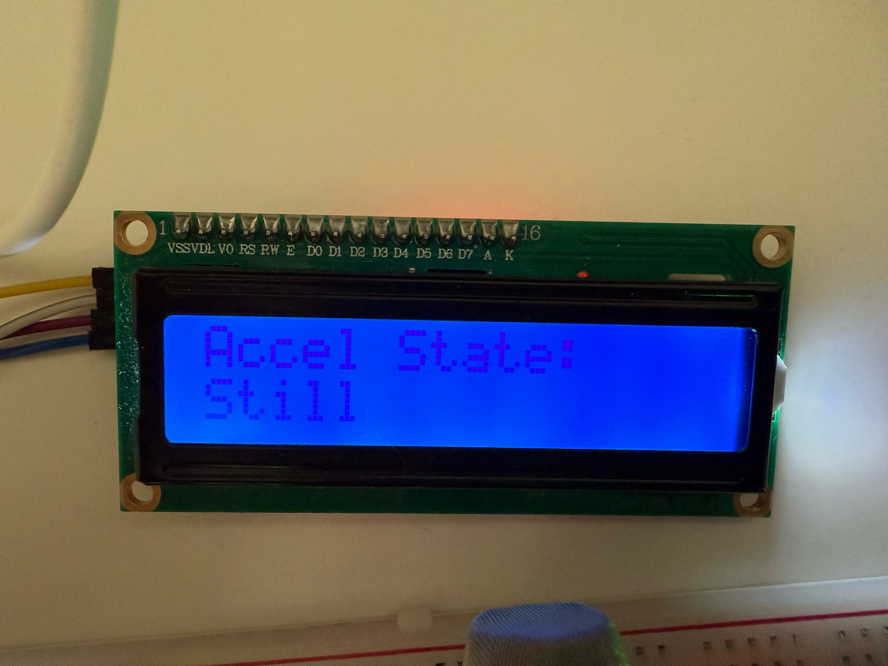
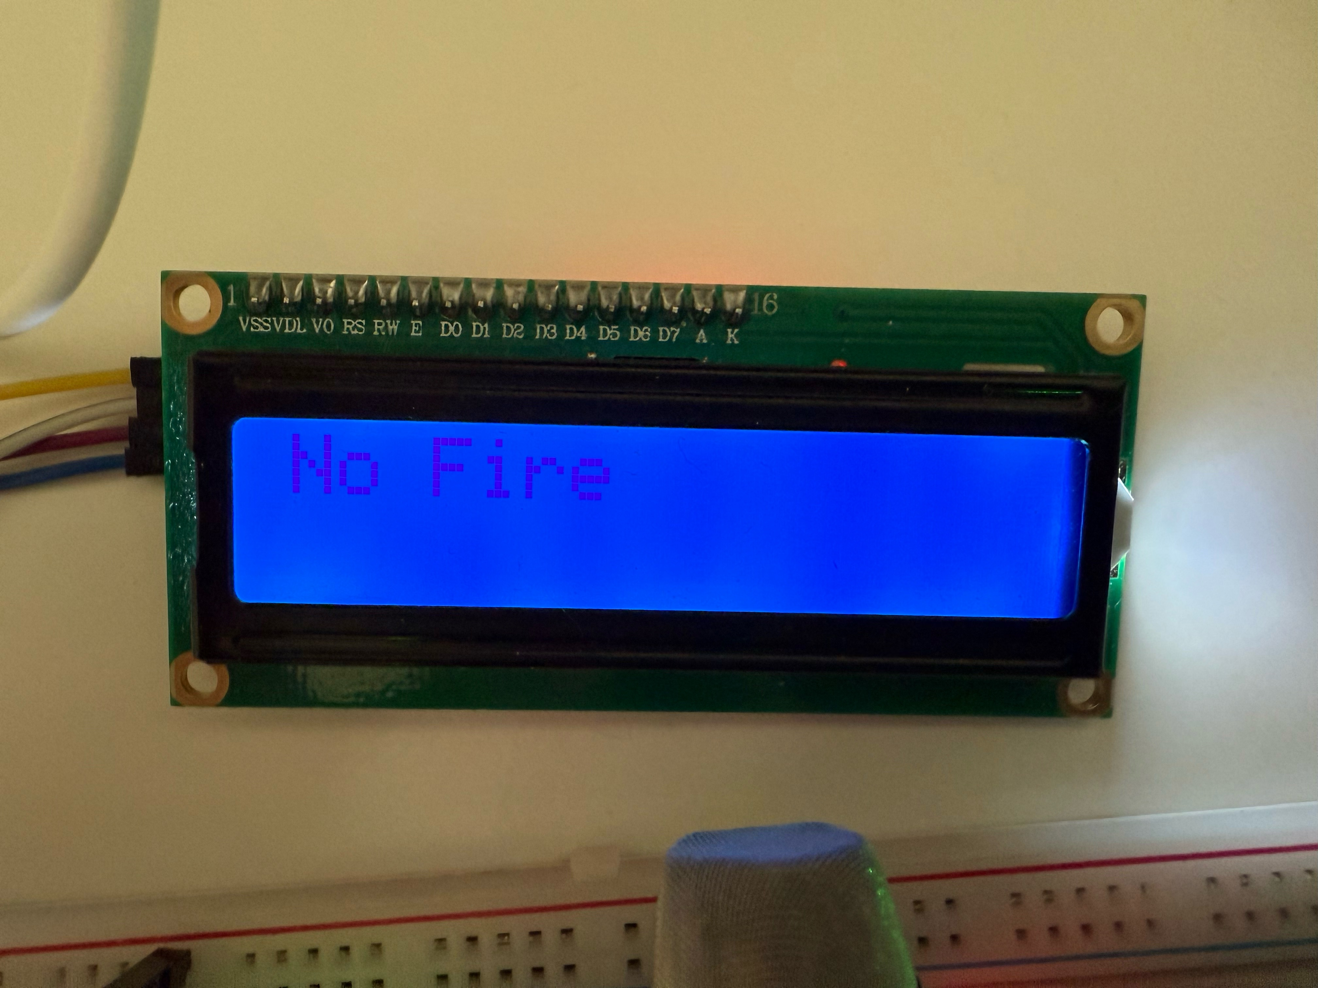
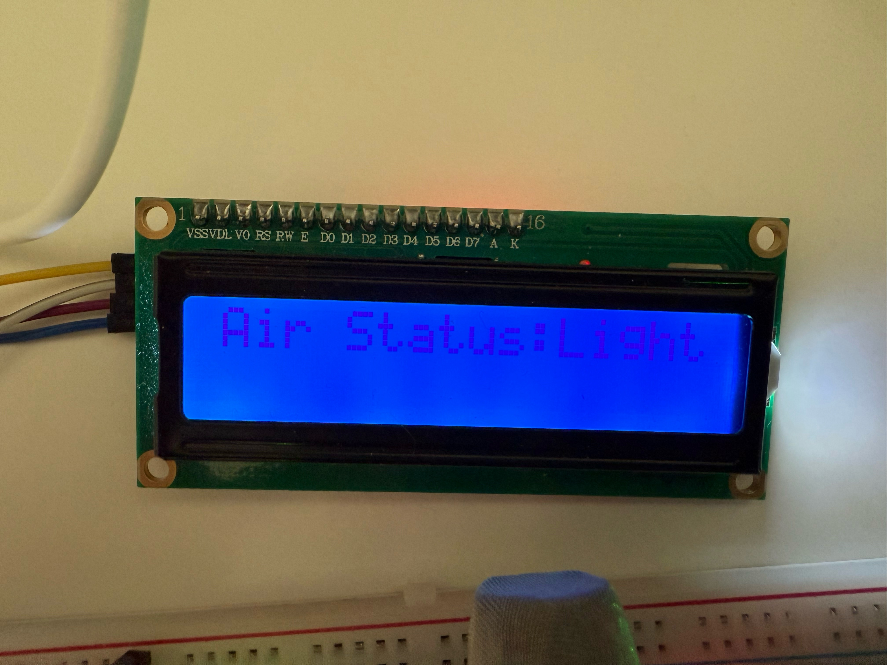
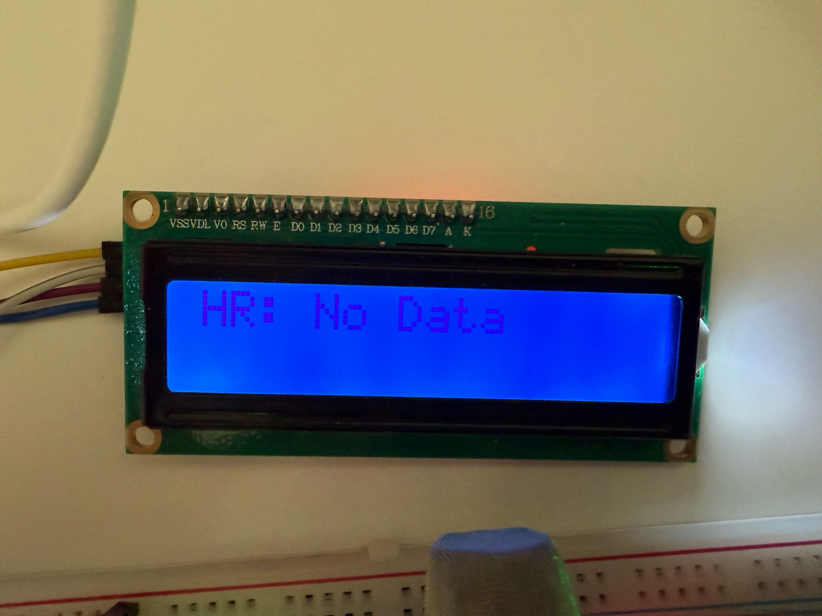
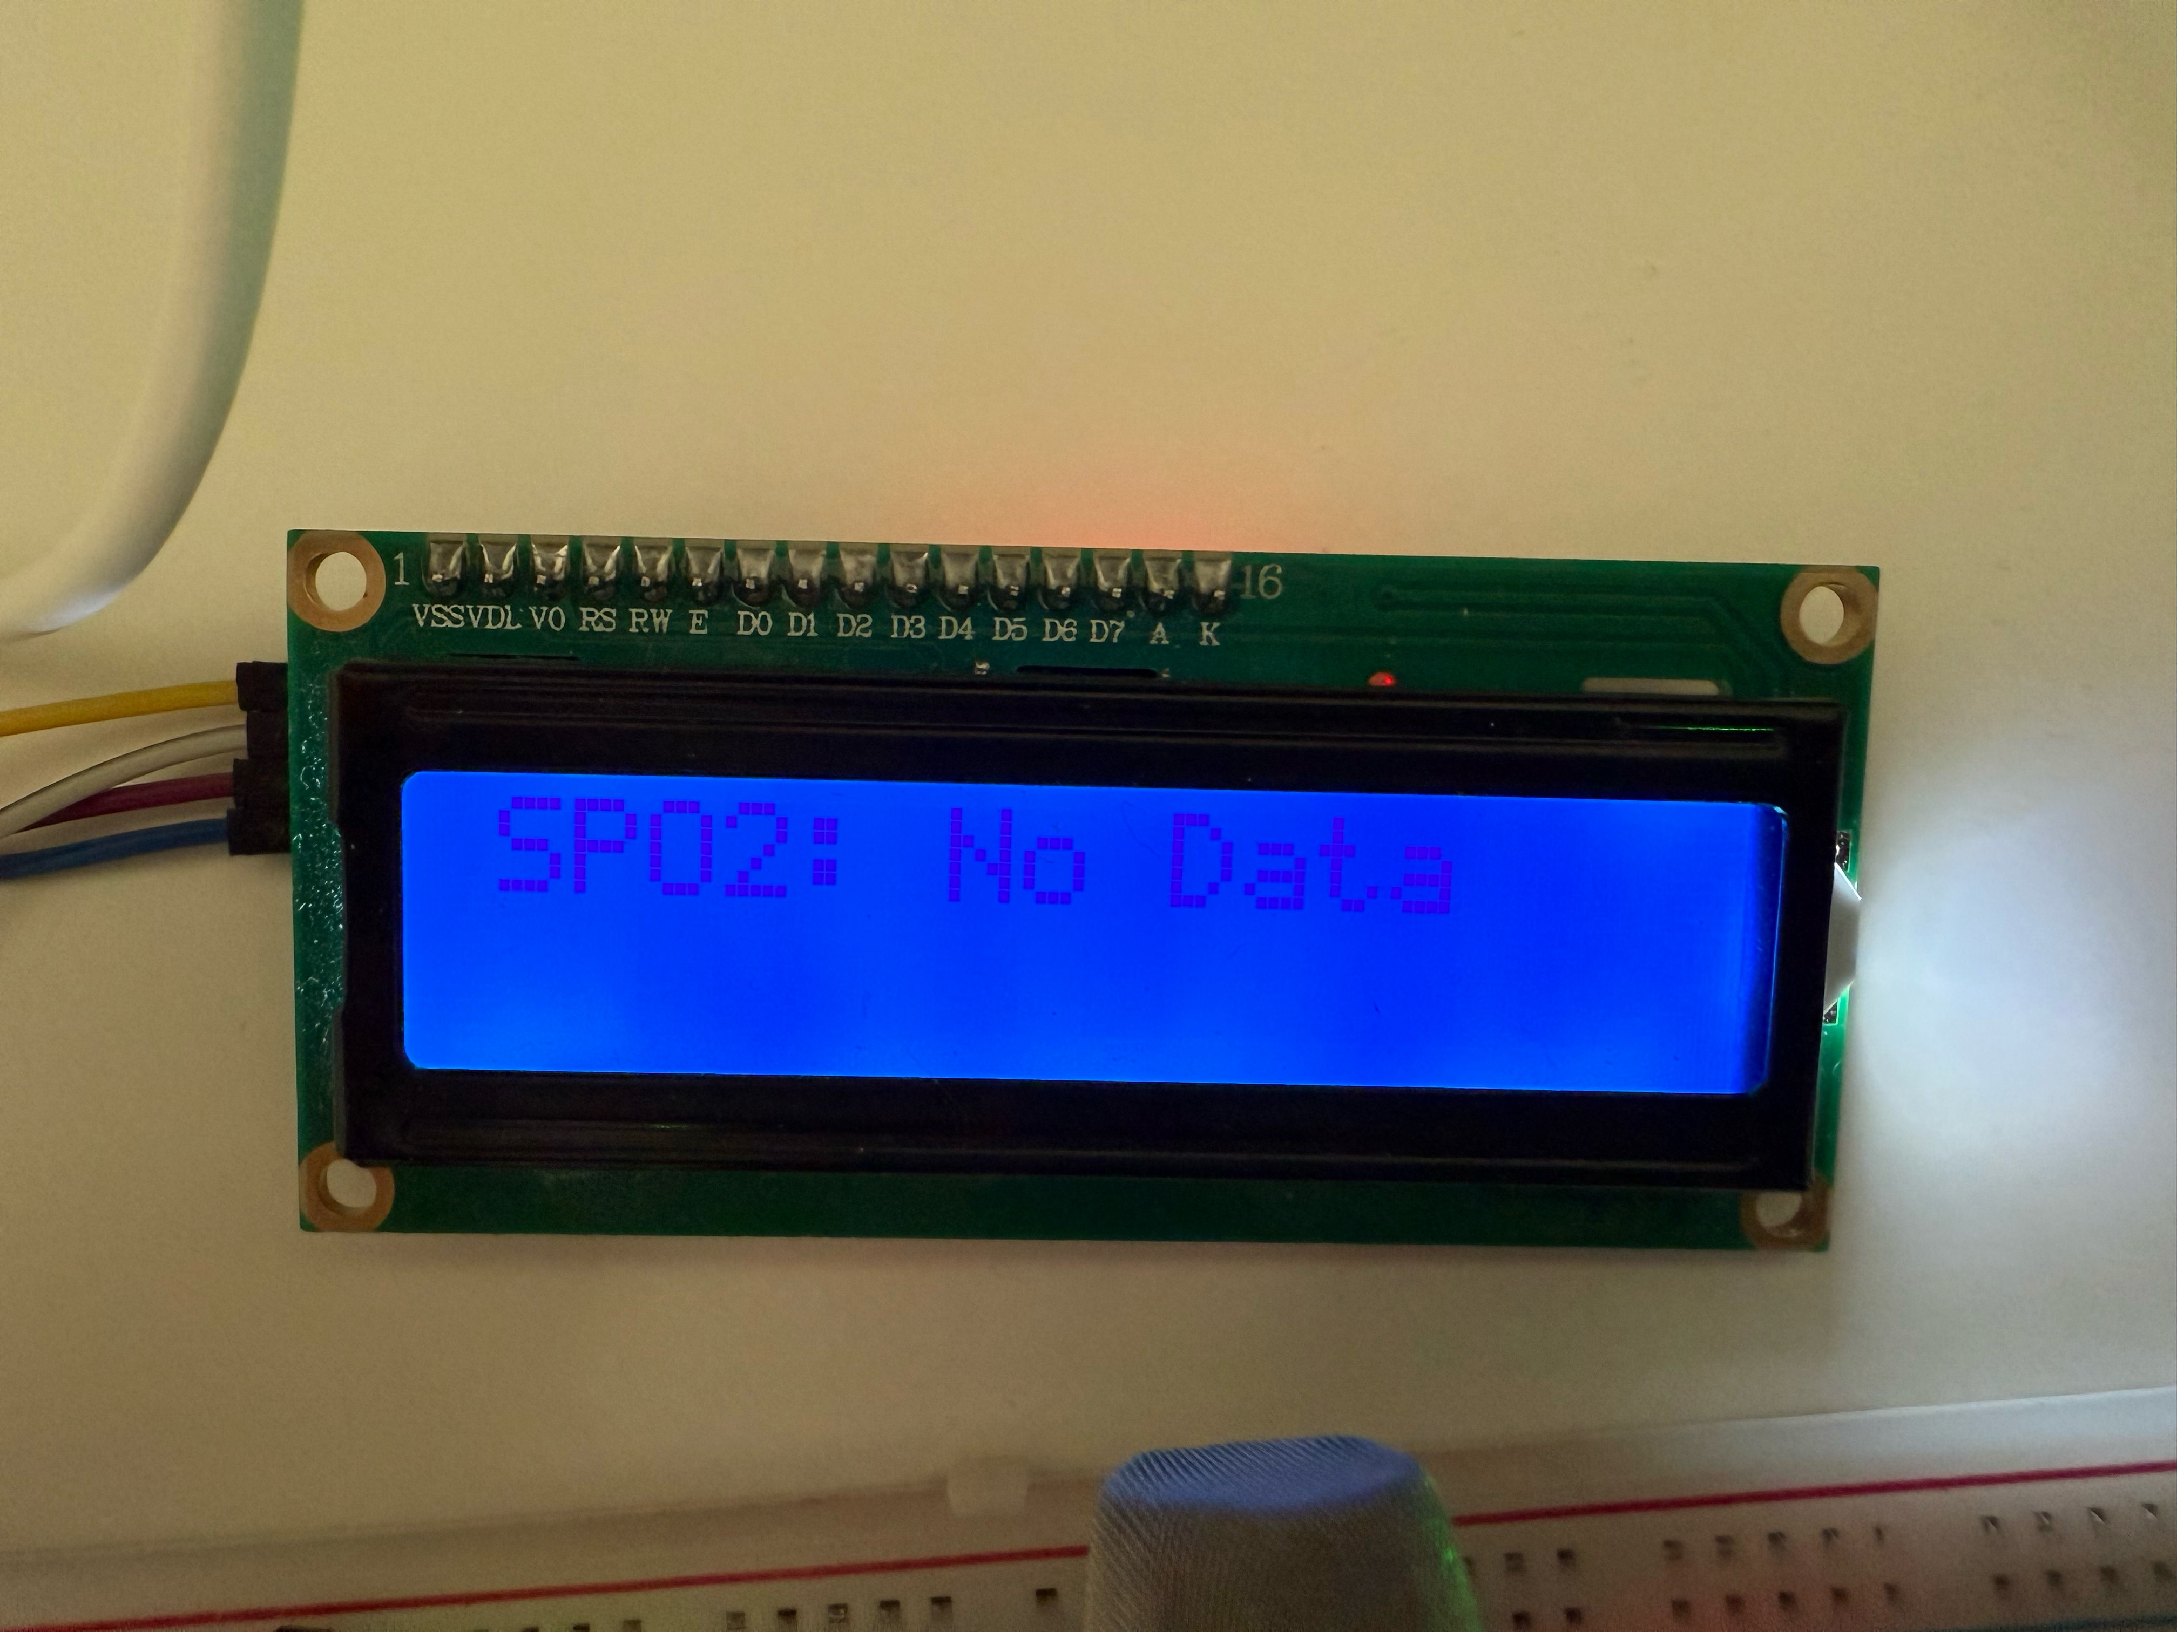
Sensor Acquisition Module
1602 Display

Slide 10
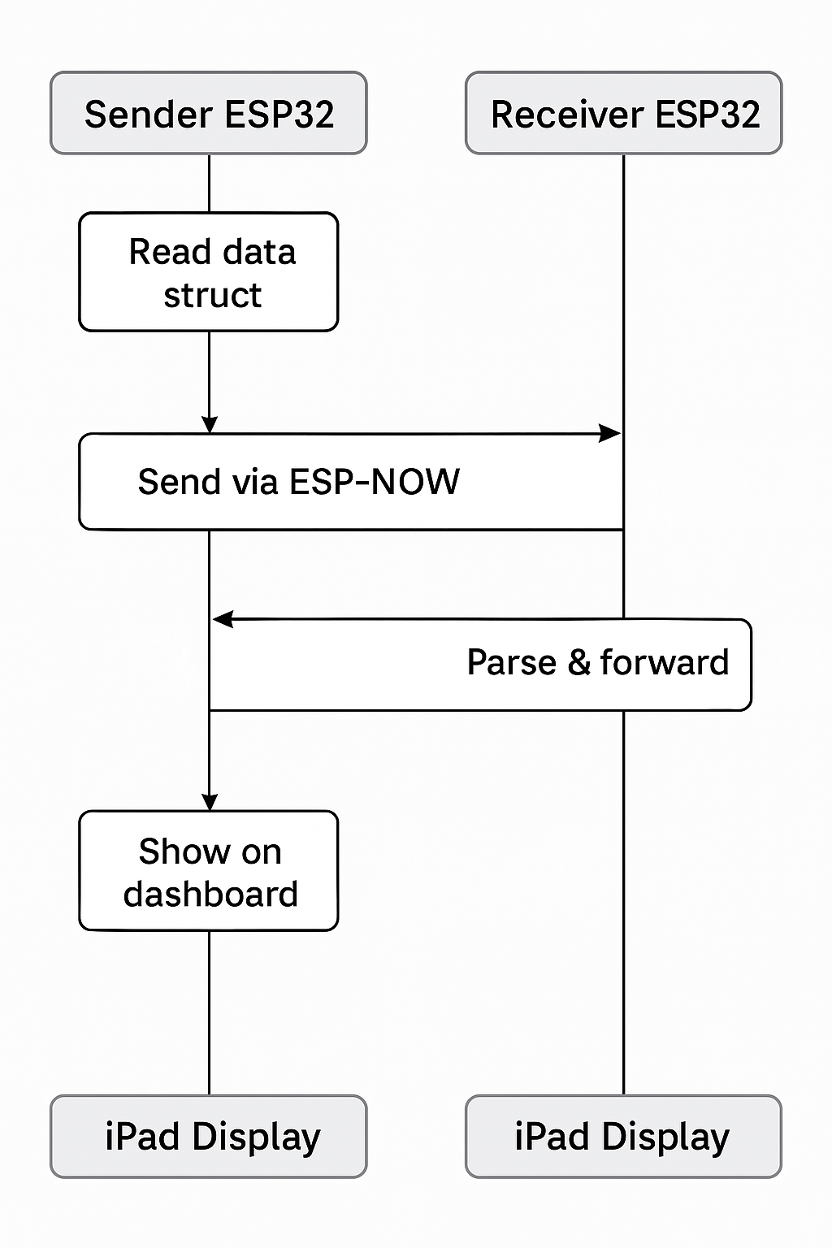
Wireless Transmission Using ESP-NOW
Protocol: ESP-NOW (low latency, point-to-point, no WiFi router required)
Sent data structure: Contains float type temperature/heart rate/acceleration, etc.
Data update frequency: 1Hz
Anti-packet loss mechanism: detect disconnection, automatically reconnect

Slide 11
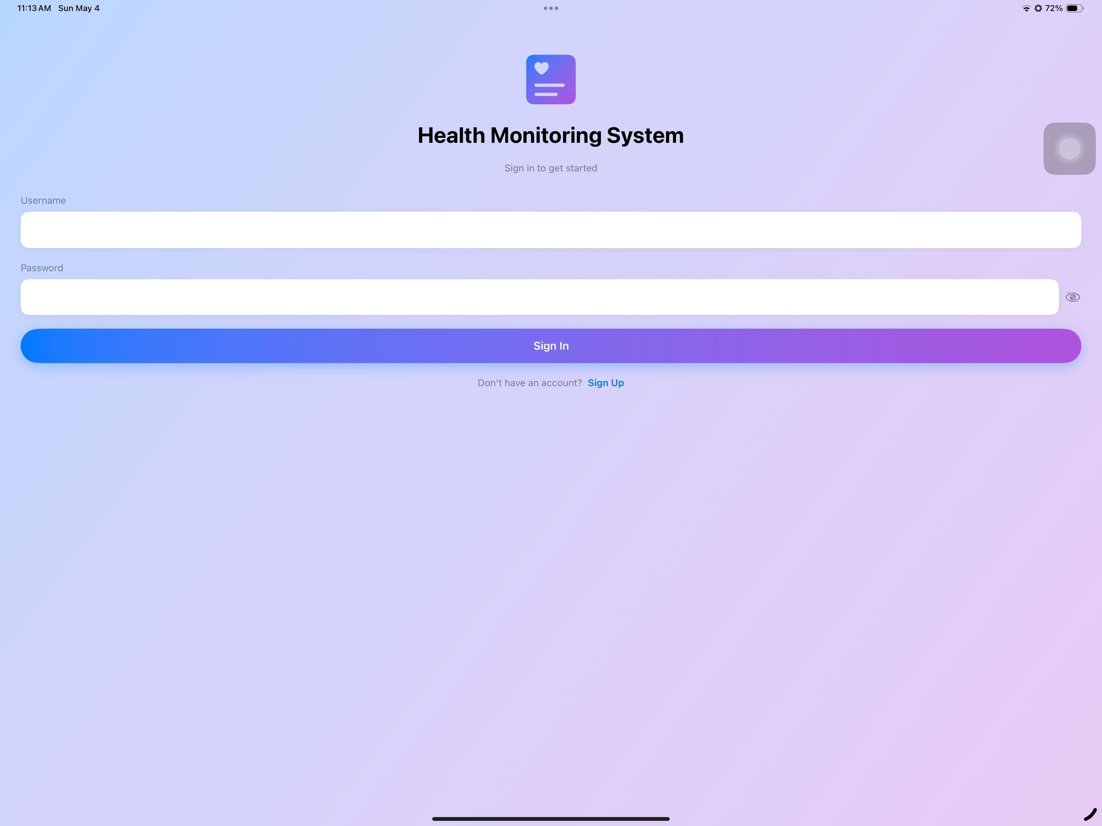
iPad Dashboard Interface
Development environment: SwiftUI
Display content: real-time data changes + charts + alerts
User operation: adjustable thresholds

Slide 12
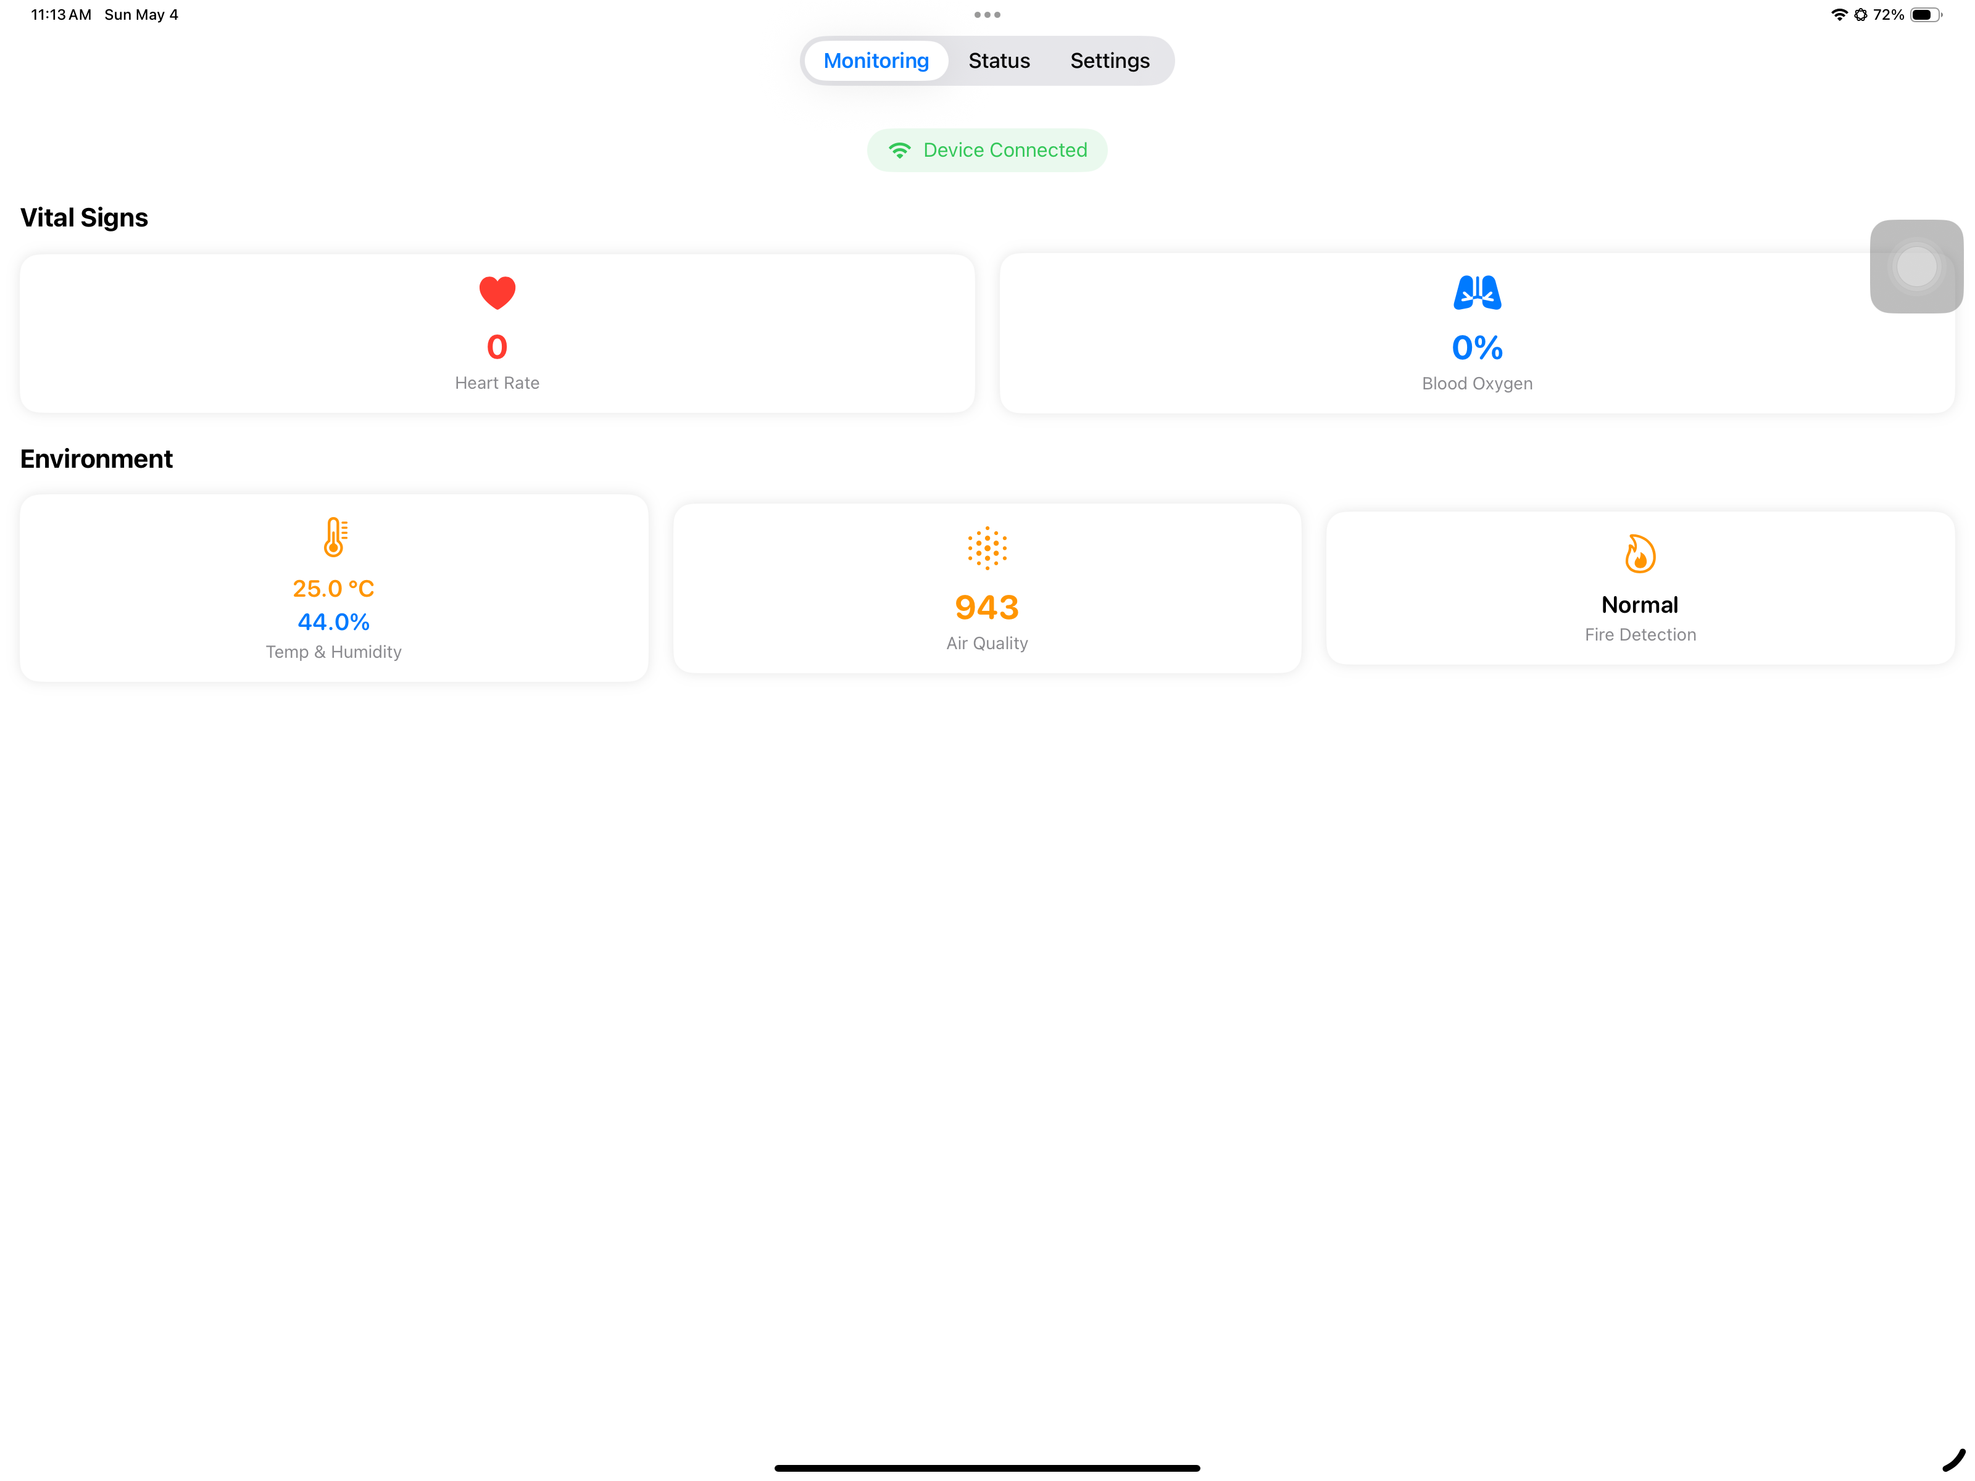
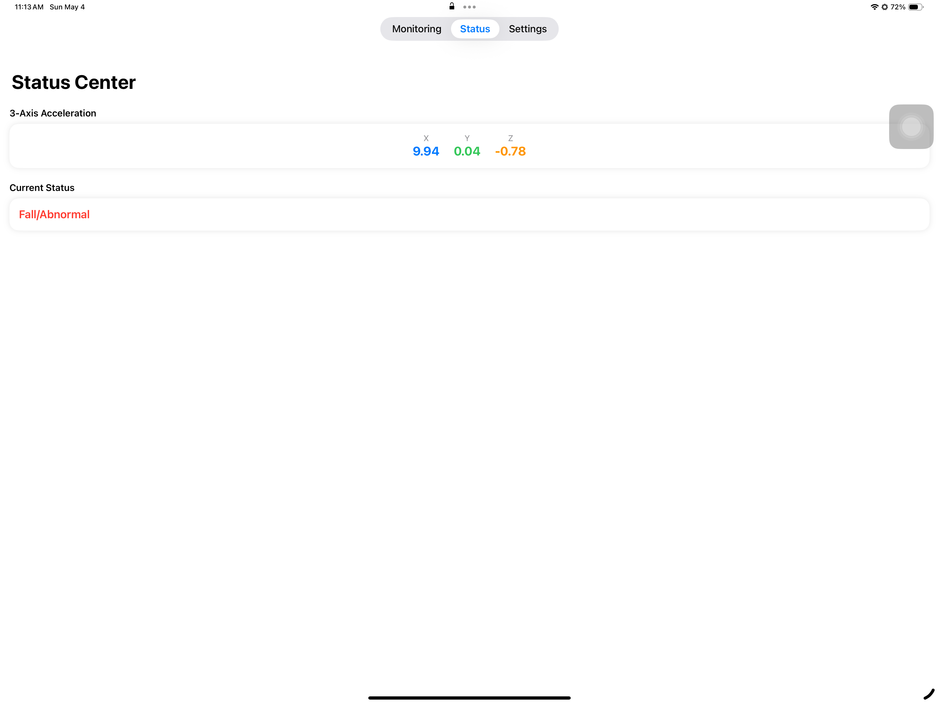
iPad Dashboard Interface

Slide 13
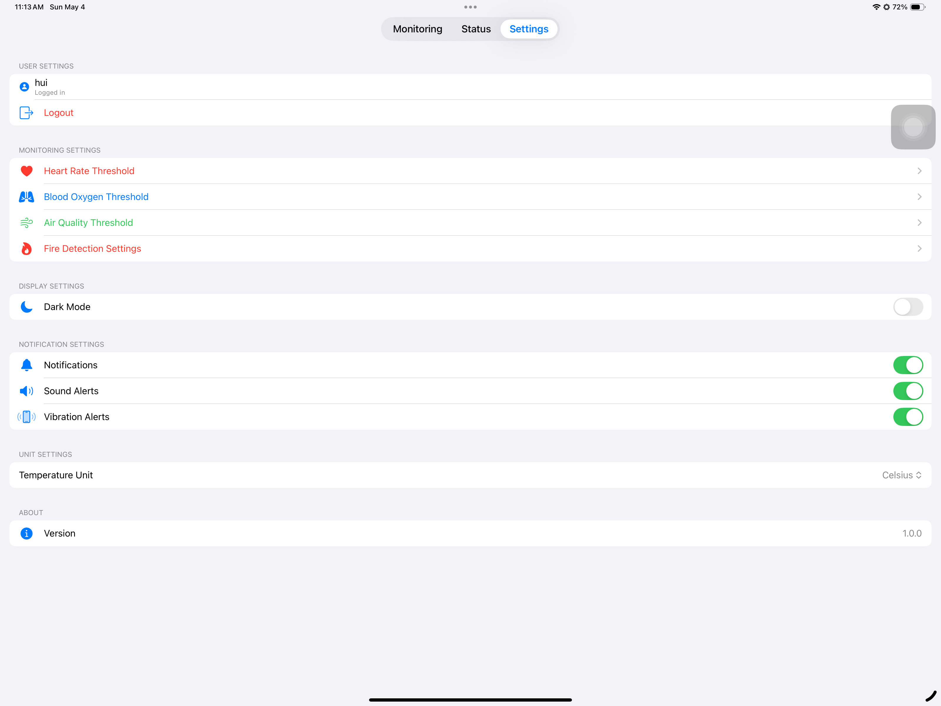
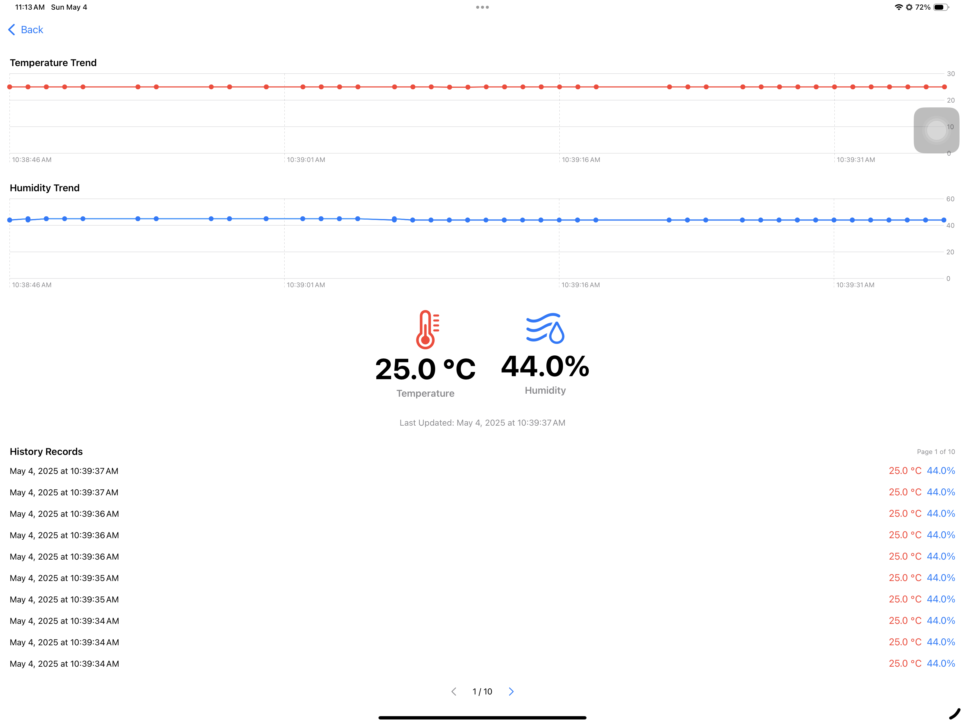
iPad Dashboard Interface

Slide 14
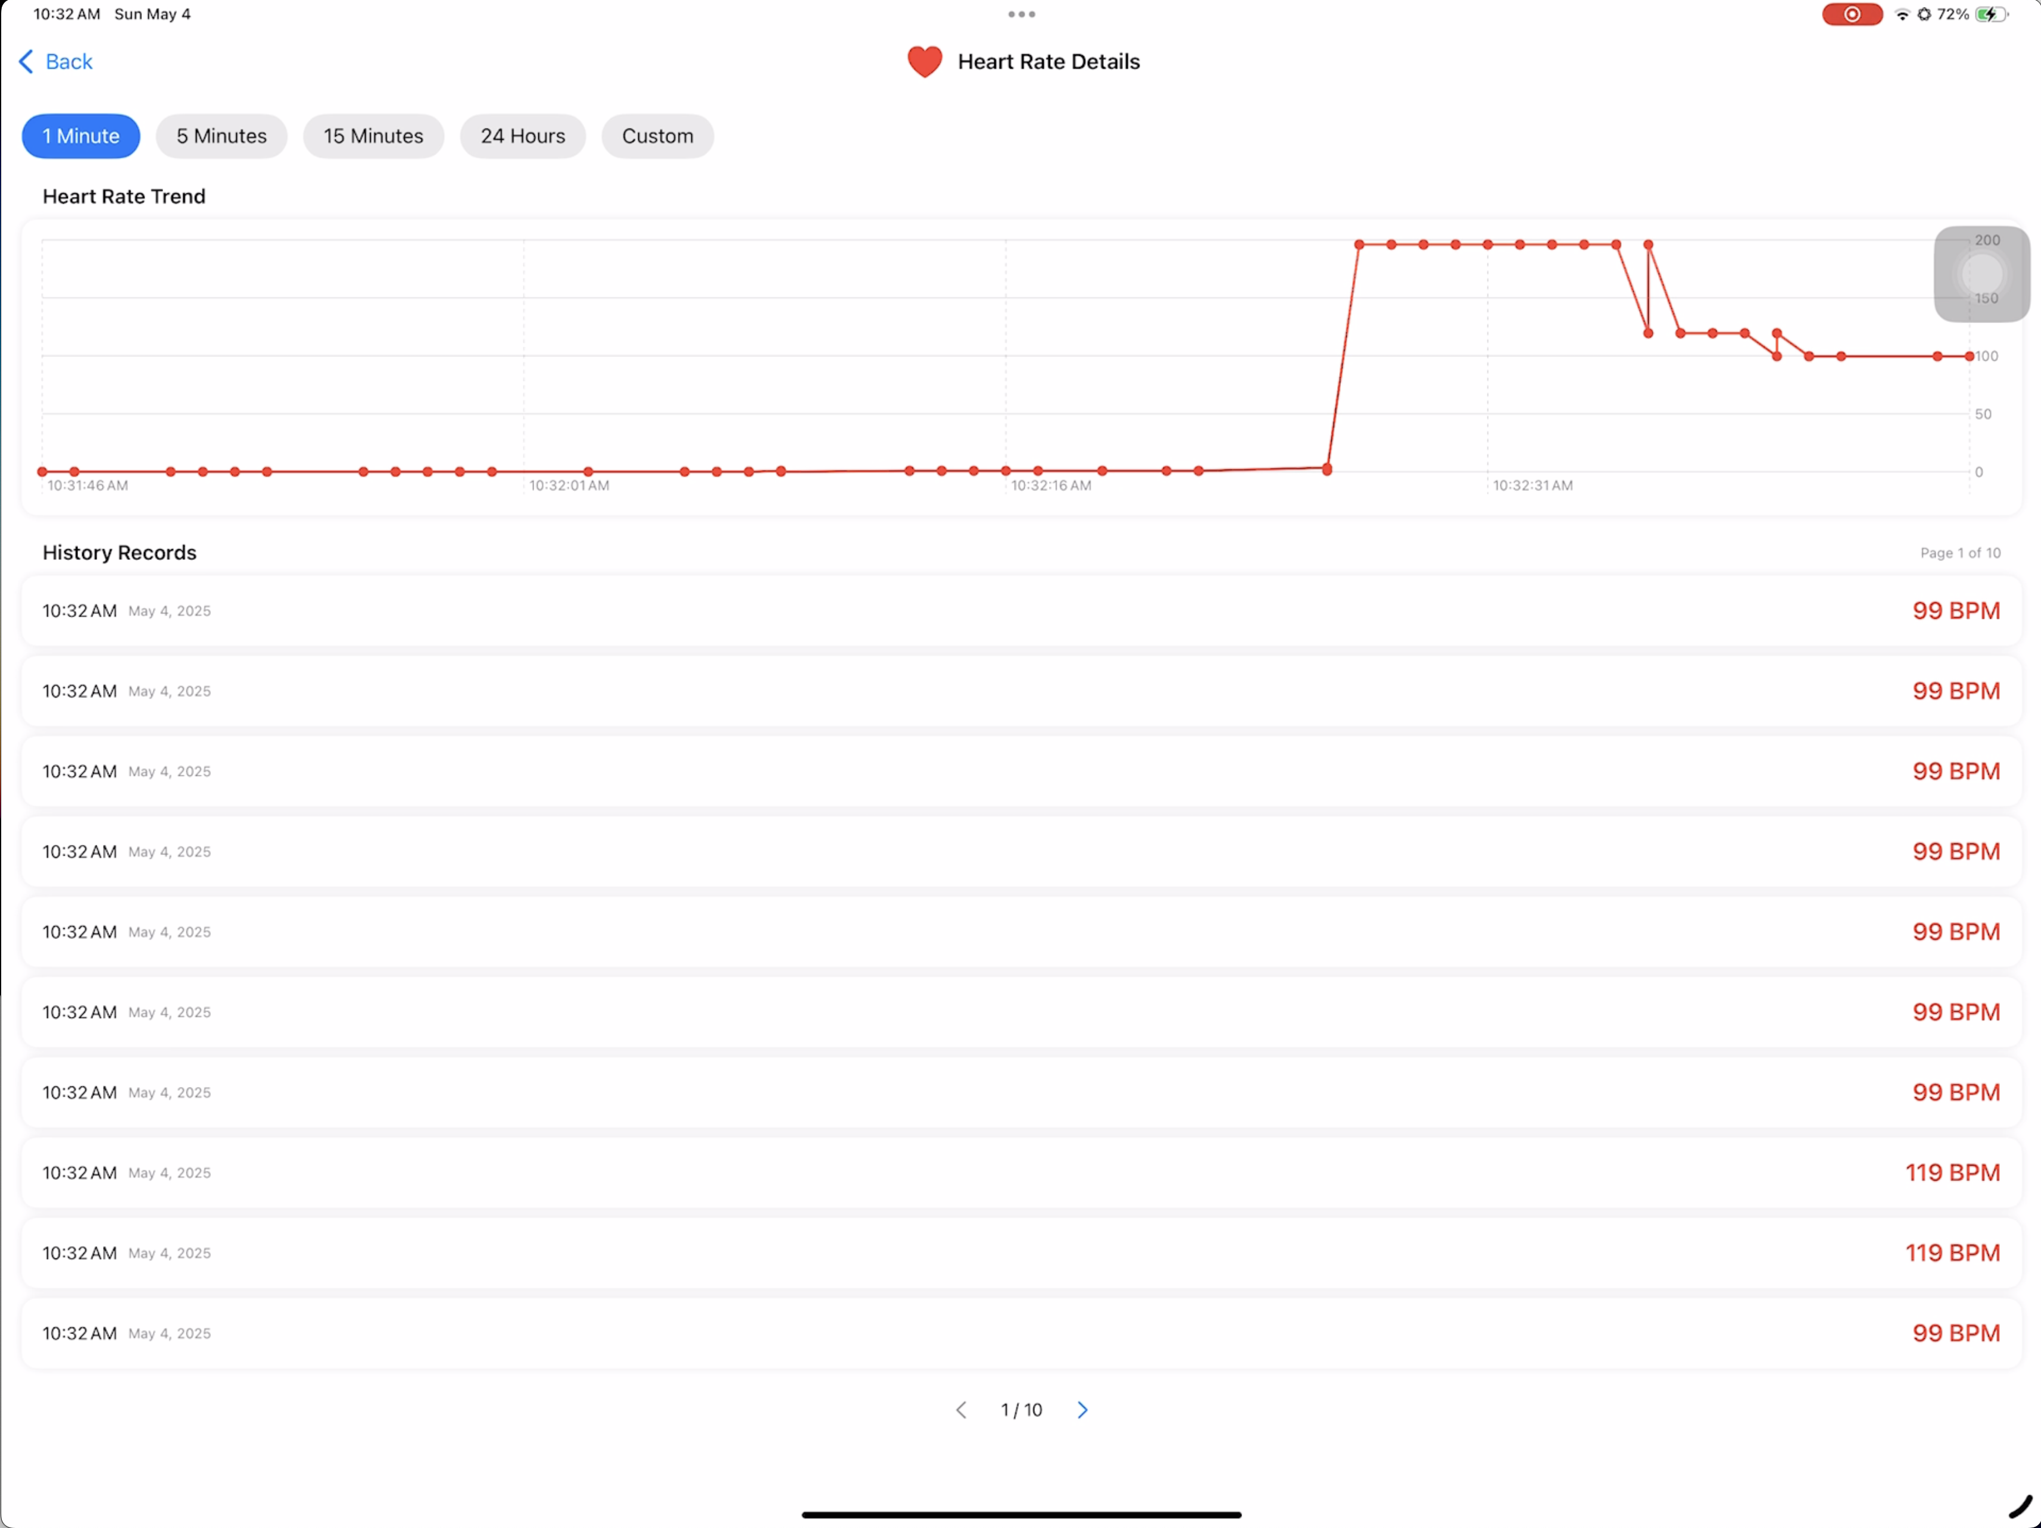
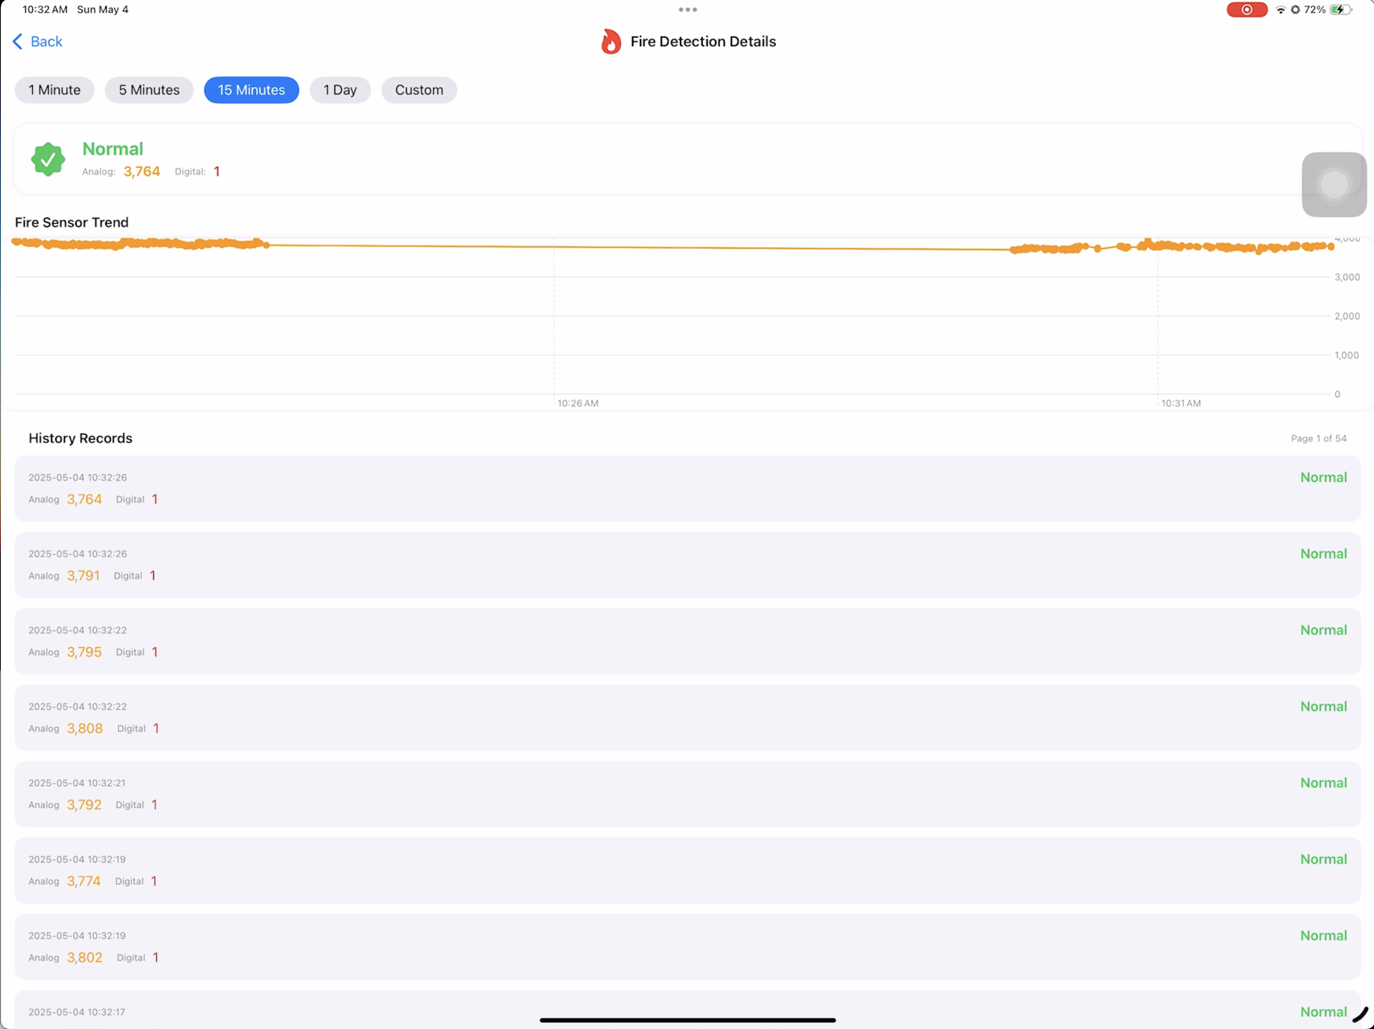
iPad Dashboard Interface

Slide 15
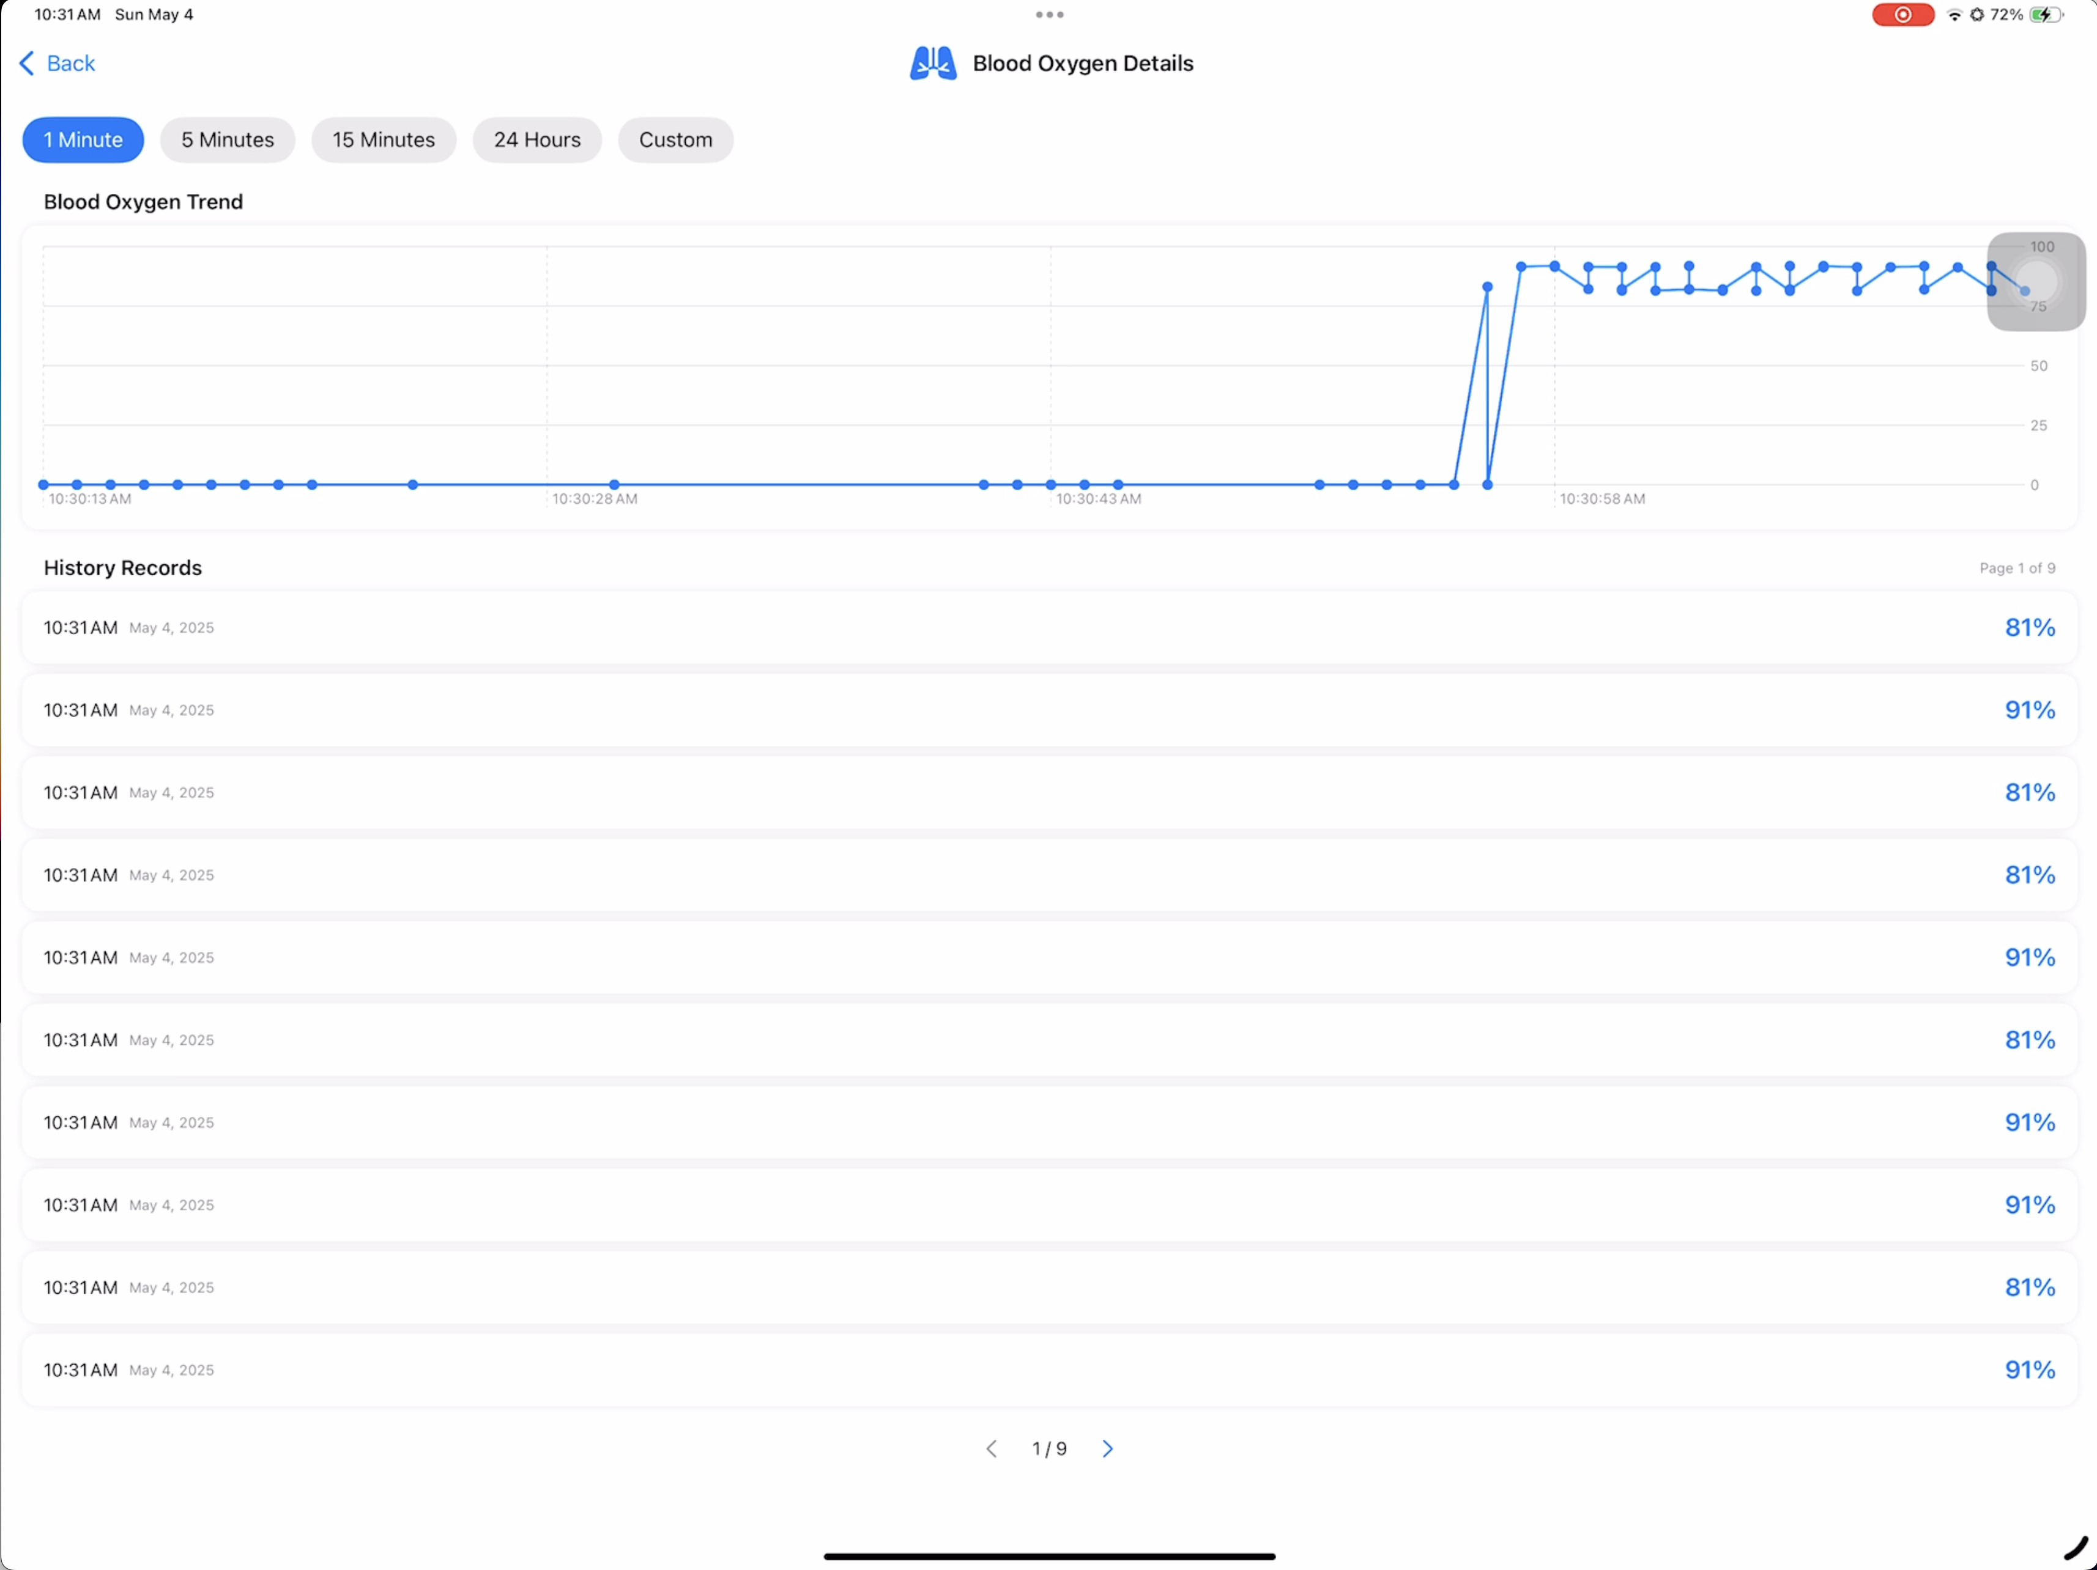
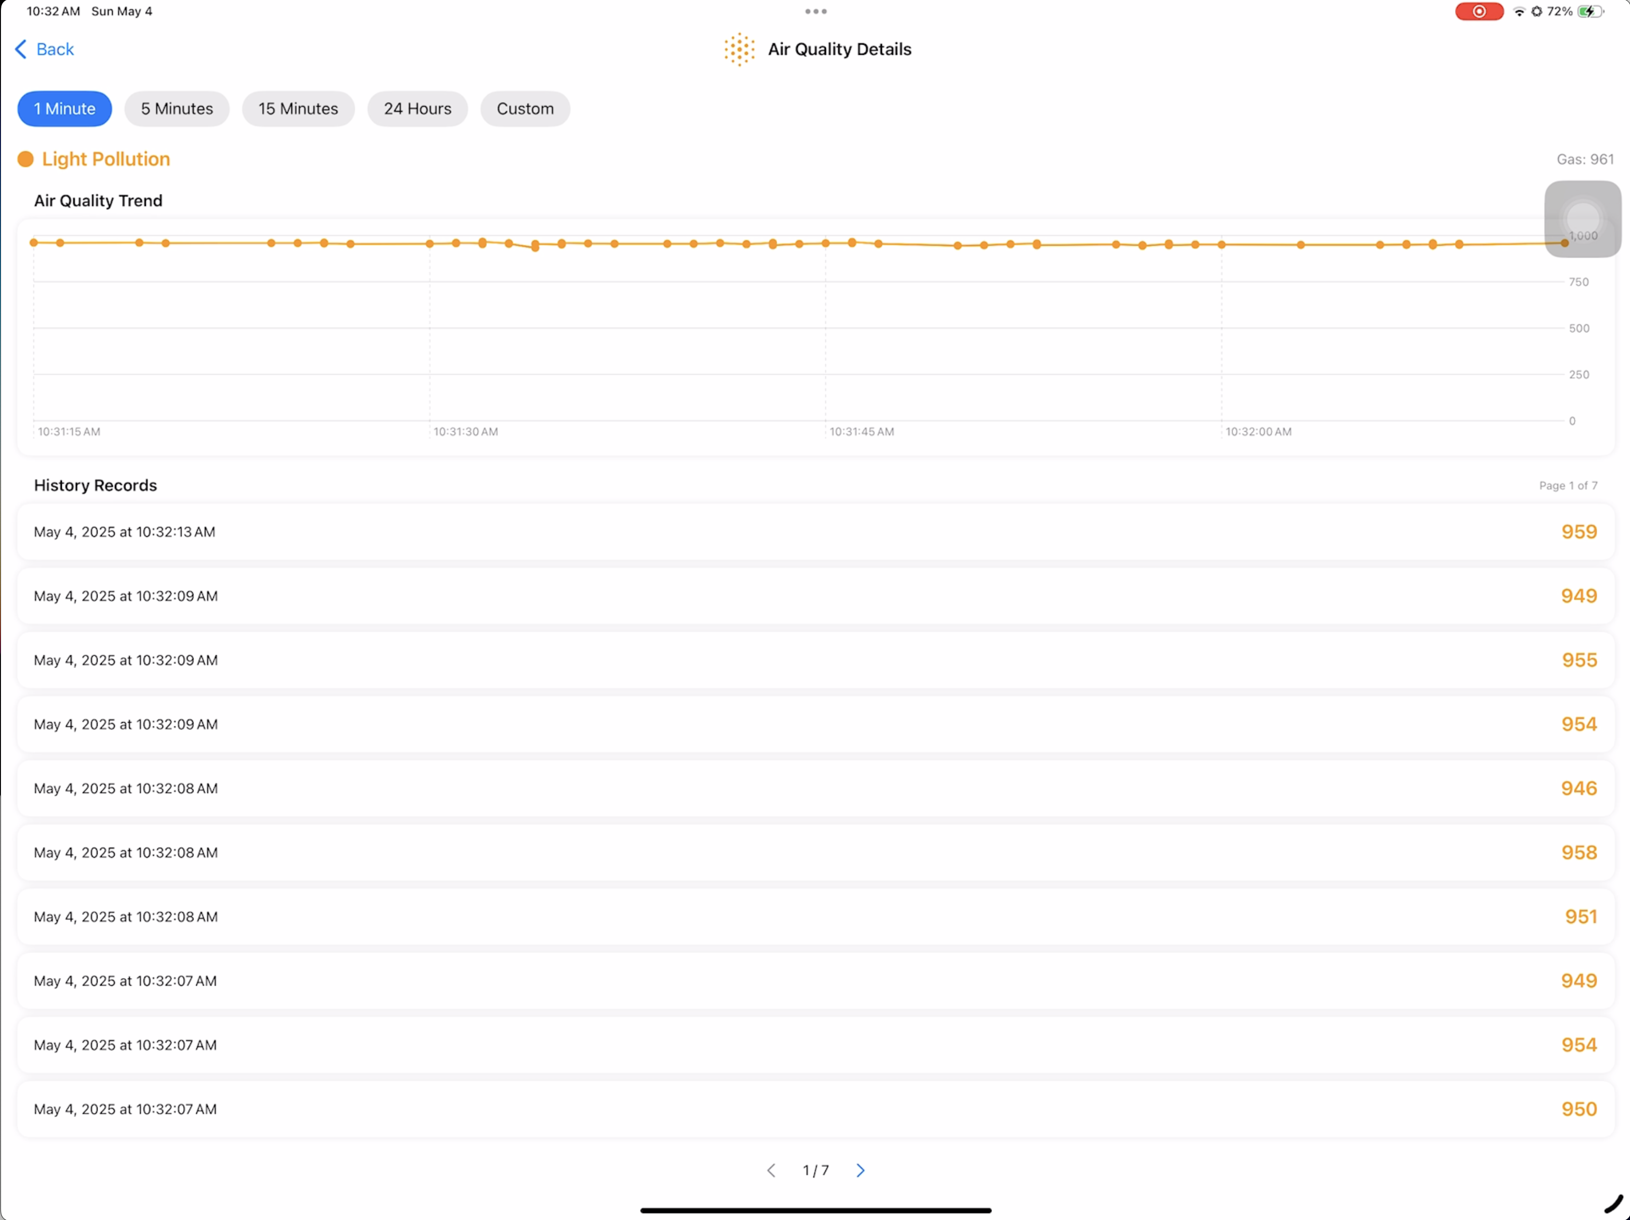
iPad Dashboard Interface

Slide 16
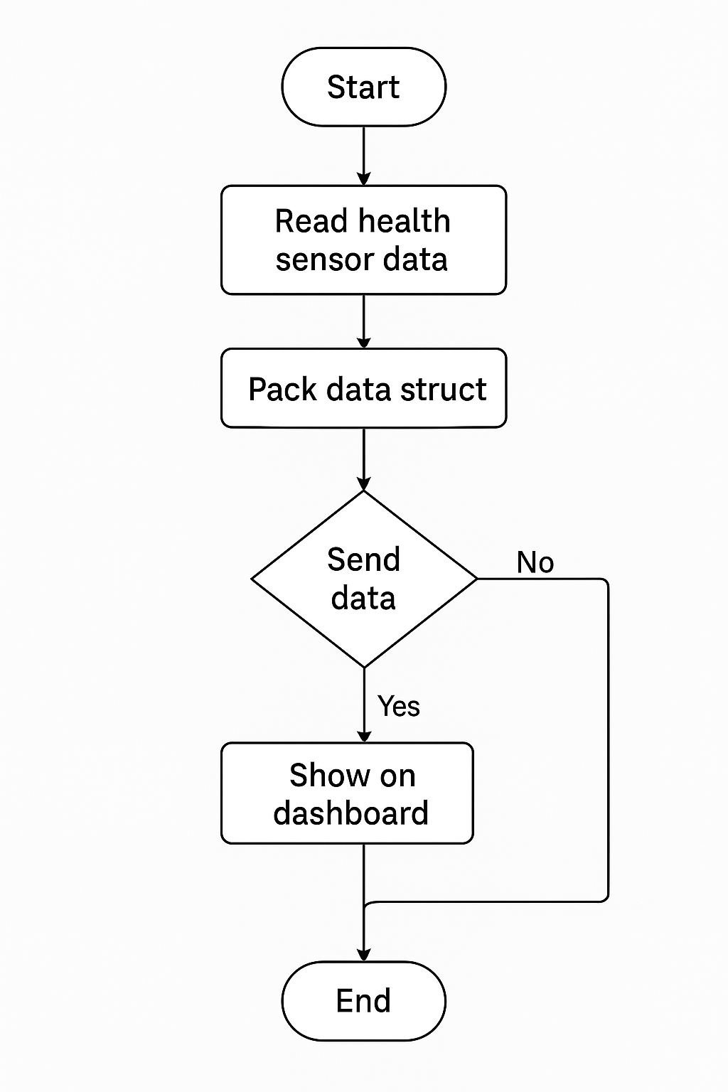
System Workflow
ESP32 initialization → data collection → determine whether to trigger an alarm
If abnormal → add prompt text (such as "flame alarm")
Normal → send data regularly → iPad update interface

Slide 17
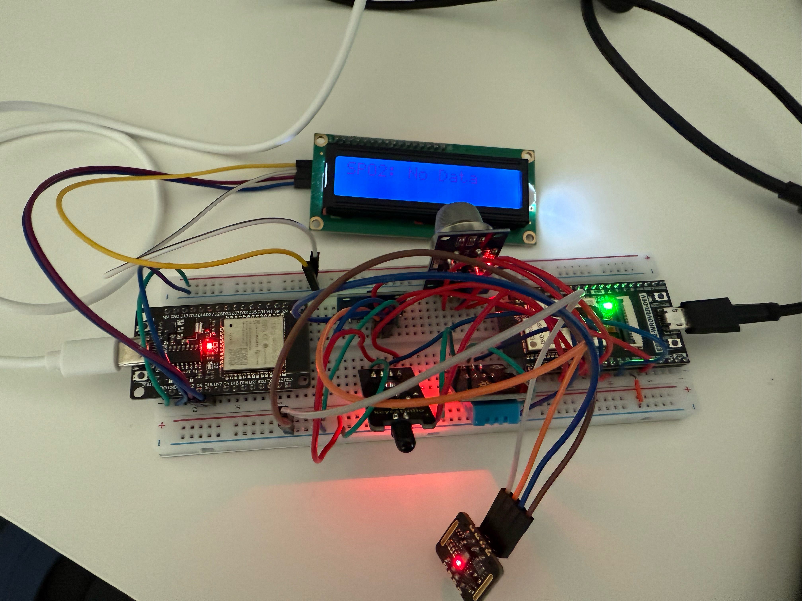
System Demonstration

Slide 18
Experimental Results & Performance
Test method: 10 sets of simulated data, actual human body test, flame ignition simulation
Success rate: 98% data successfully transmitted
Delay: average < 250ms
Alarm error rate: 5% (heart rate inaccurate in high light and occlusion)

Slide 19
Conclusion & Reflection
Summary of achievements
Multi-sensor integrated system: A comprehensive monitoring system integrating multiple sensors such as temperature, humidity, acceleration, flame, gas, heart rate, blood oxygen, etc. was successfully built.
Intelligent monitoring function: Multiple intelligent monitoring functions such as fire detection, air quality monitoring, fall detection and health monitoring were developed.
User interface design: An intuitive and easy-to-use iOS monitoring interface was created, supporting real-time data display and historical data analysis.
Data communication system: A stable communication system between ESP32 and iOS devices was established, achieving reliable data transmission and storage.

Slide 20
Conclusion & Reflection
Challenge
Sensor data stability: sensor data fluctuation and noise issues need to be addressed to ensure data accuracy.
Real-time requirements: data update frequency and system performance need to be balanced to ensure real-time monitoring results.
System integration complexity: multiple sensors need to be coordinated to ensure overall system stability.
User interface design: a simple and intuitive interface needs to be designed while displaying a large amount of real-time data.
Communication reliability: network instability needs to be handled to ensure data transmission reliability.
Threshold setting optimization: appropriate monitoring thresholds need to be determined to balance false alarm rate and missed alarm rate.

Slide 21
Future Work
Add voice broadcast or SMS reminder
Small PCB board design, replace breadboard
Enhance fall detection algorithm (integrate YOLO or OpenPose)

Slide 22




Team Contribution & Acknowledgment
Name | Responsibility
Hui Jin | iPad interface design and communication protocol
Jiarui Zhu | ESP32 programming and sensor debugging
Changyu Liu | System structure design and process documentation
Yiyang Liu | Experimental analysis and report compilation

Slide 23
